Slide 1
Editors
webstorm || atom

Slide 2
webstorm
https://www.jetbrains.com/webstorm/

Slide 3
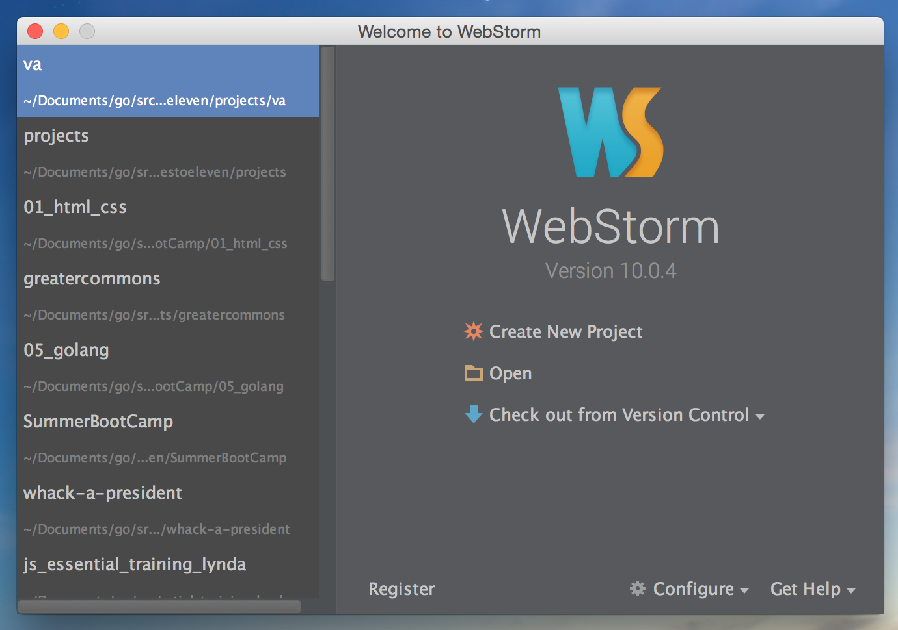

Slide 4
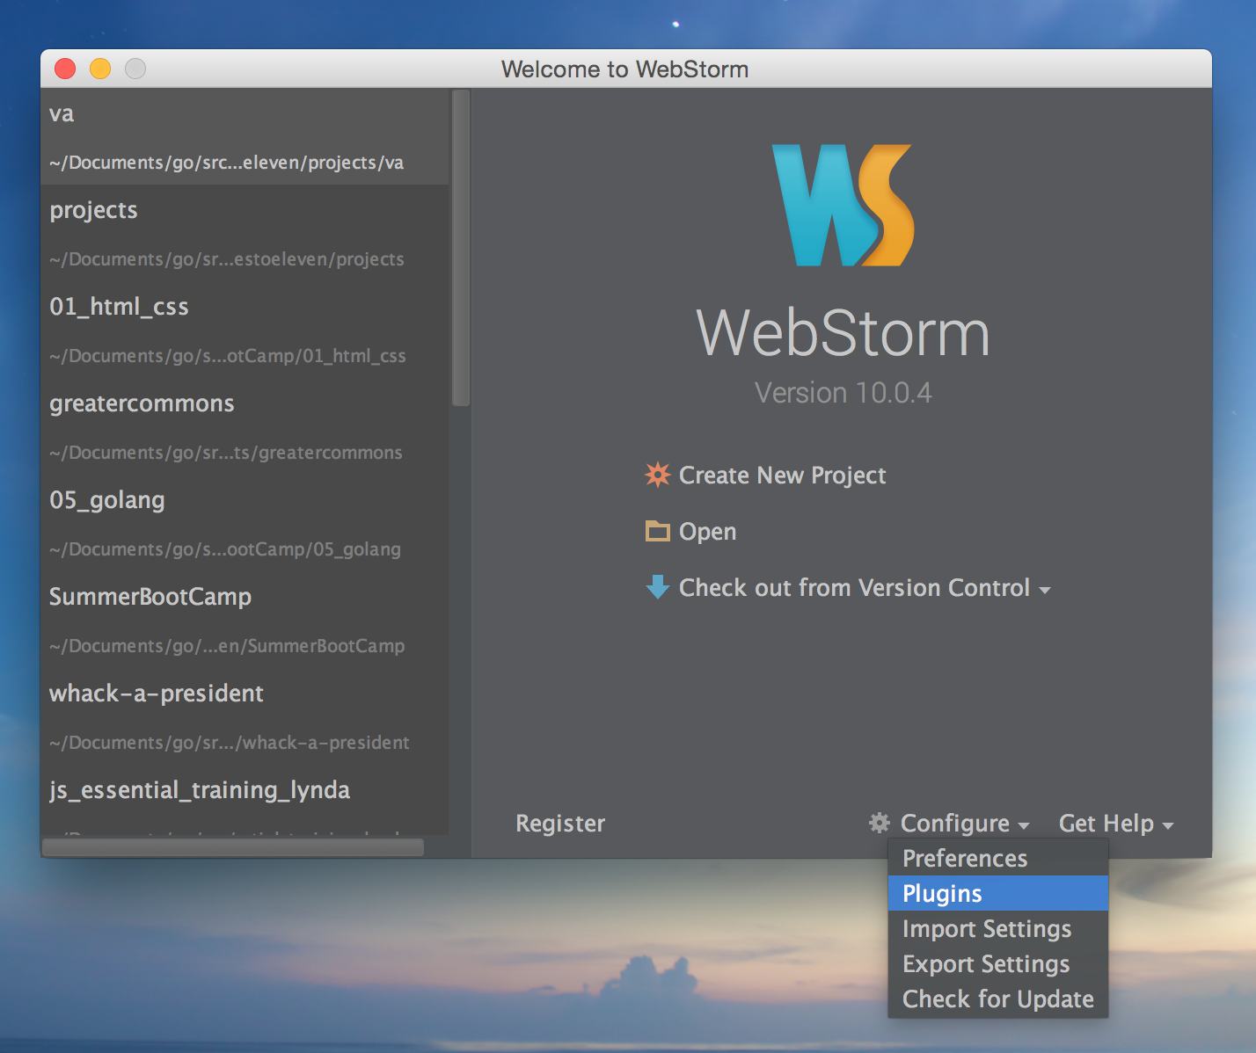

Slide 5
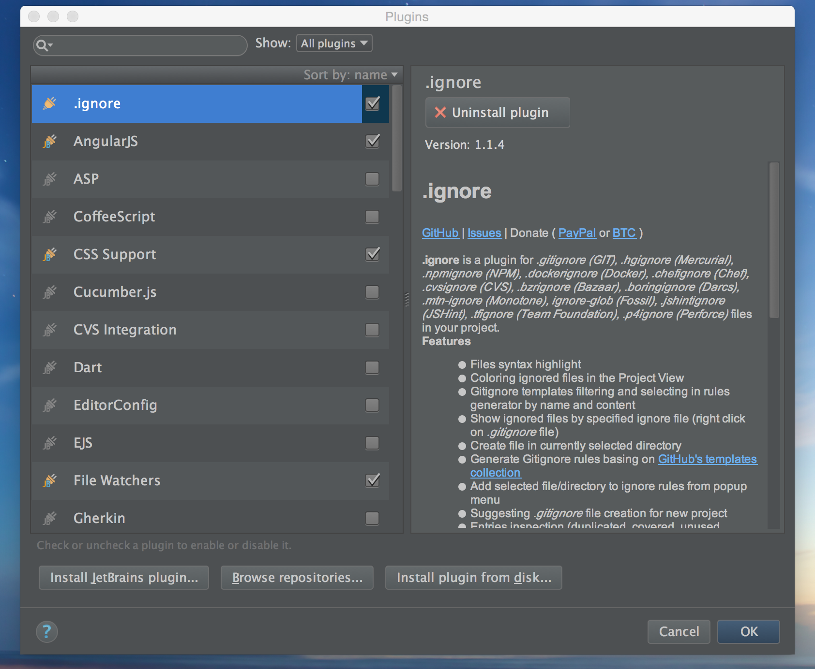

Slide 6
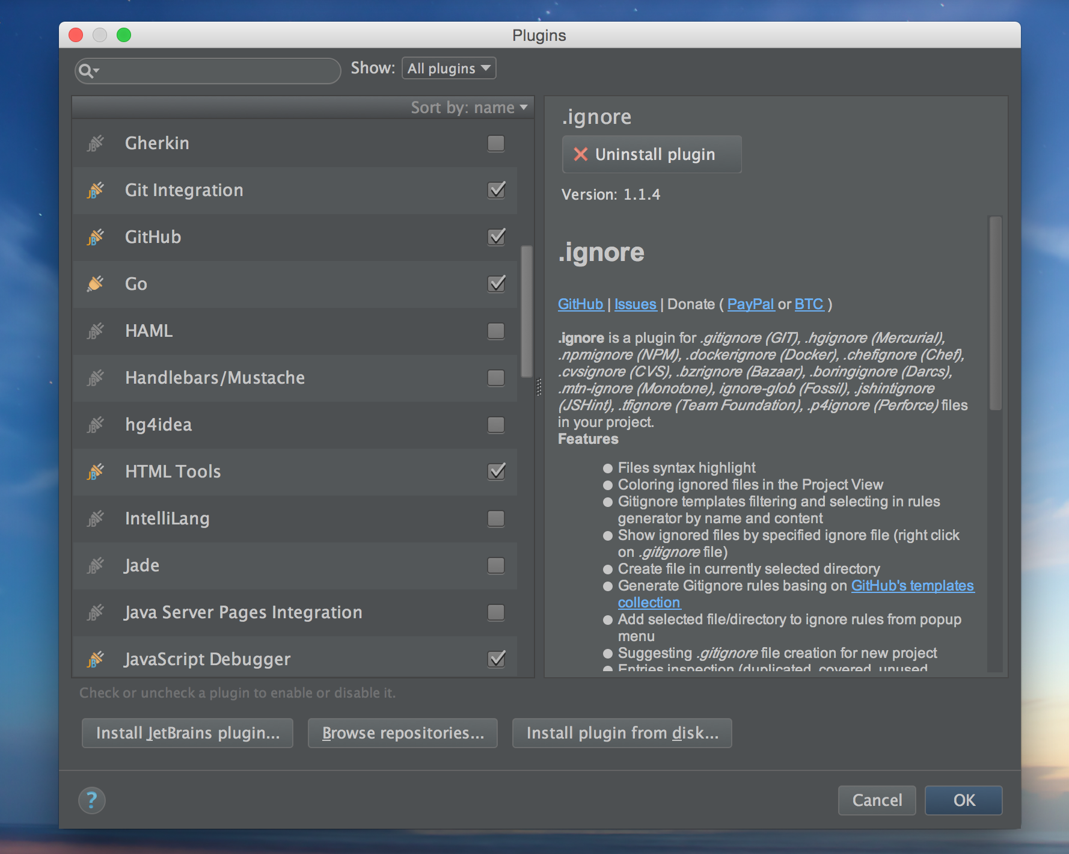

Slide 7
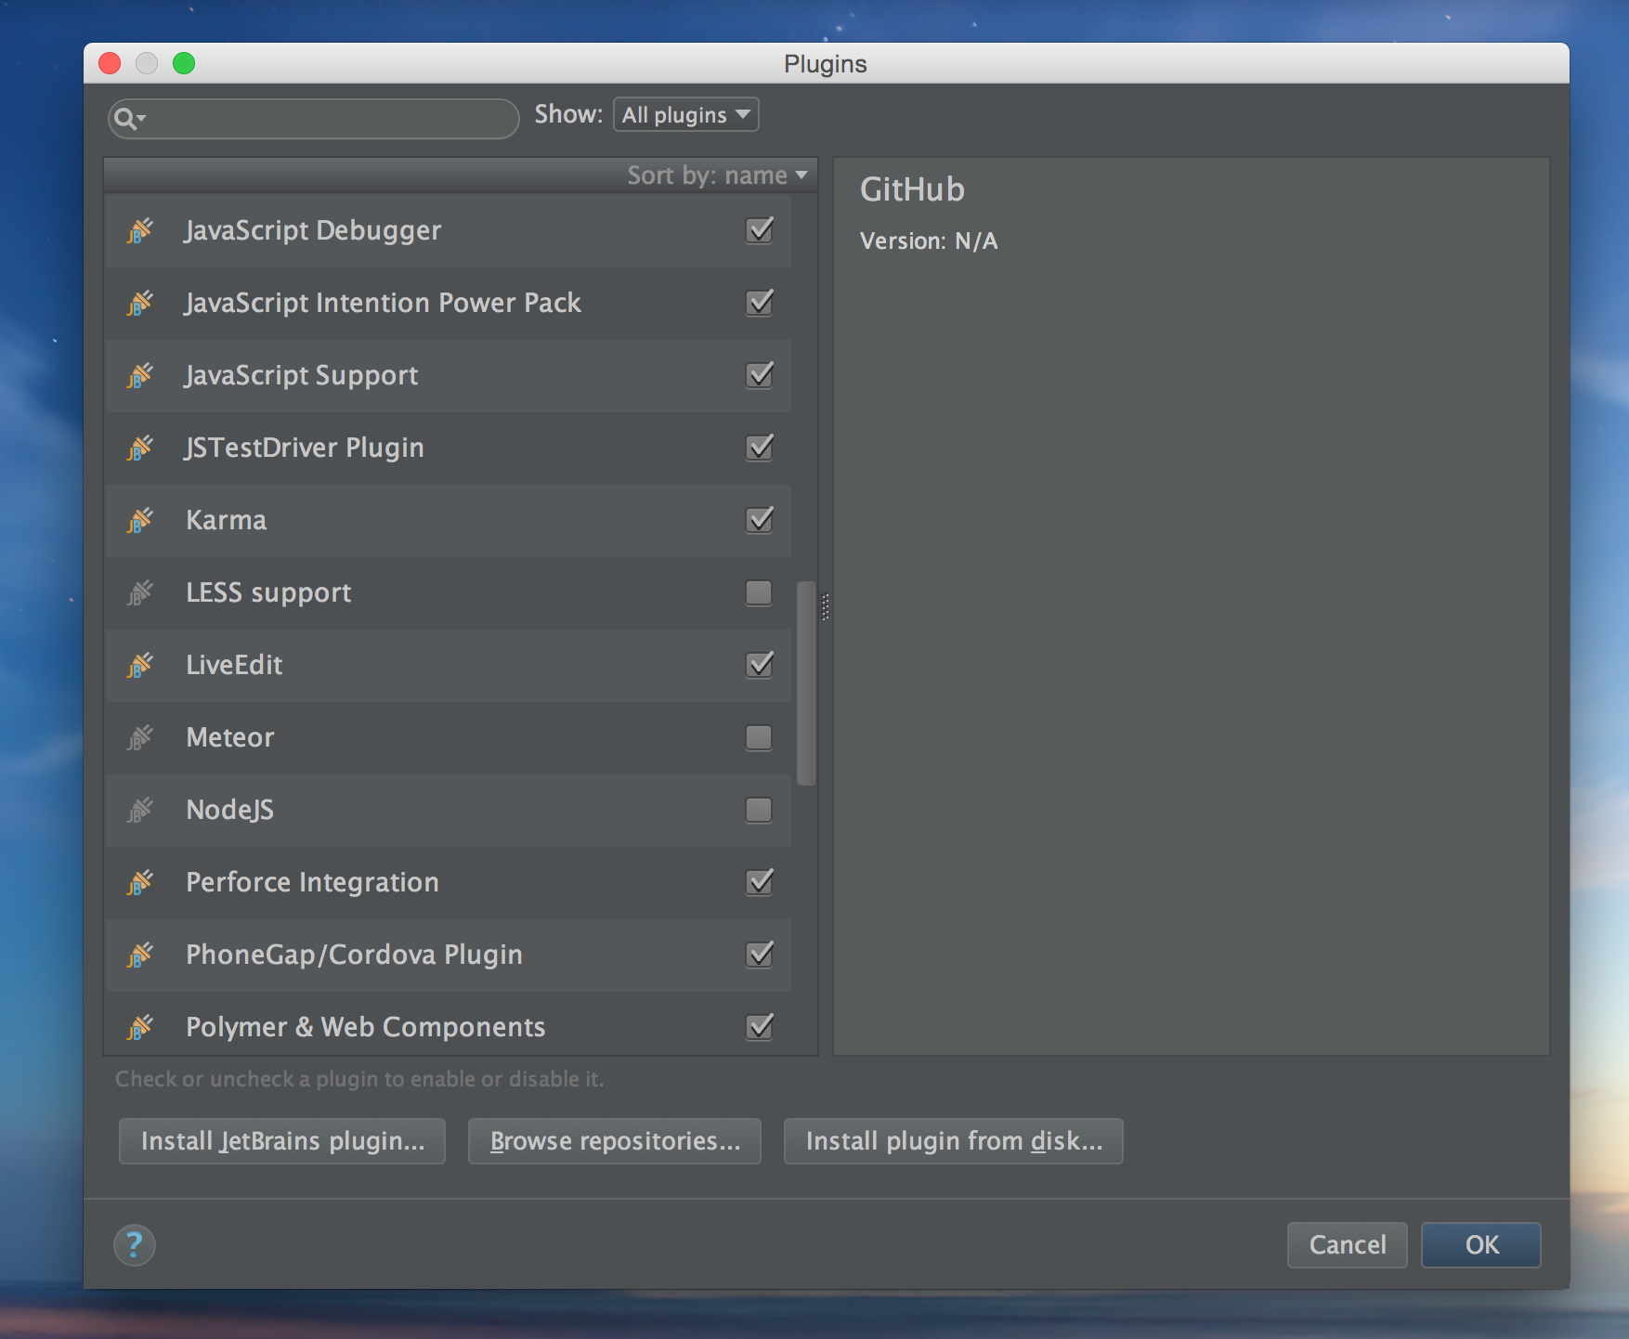

Slide 8
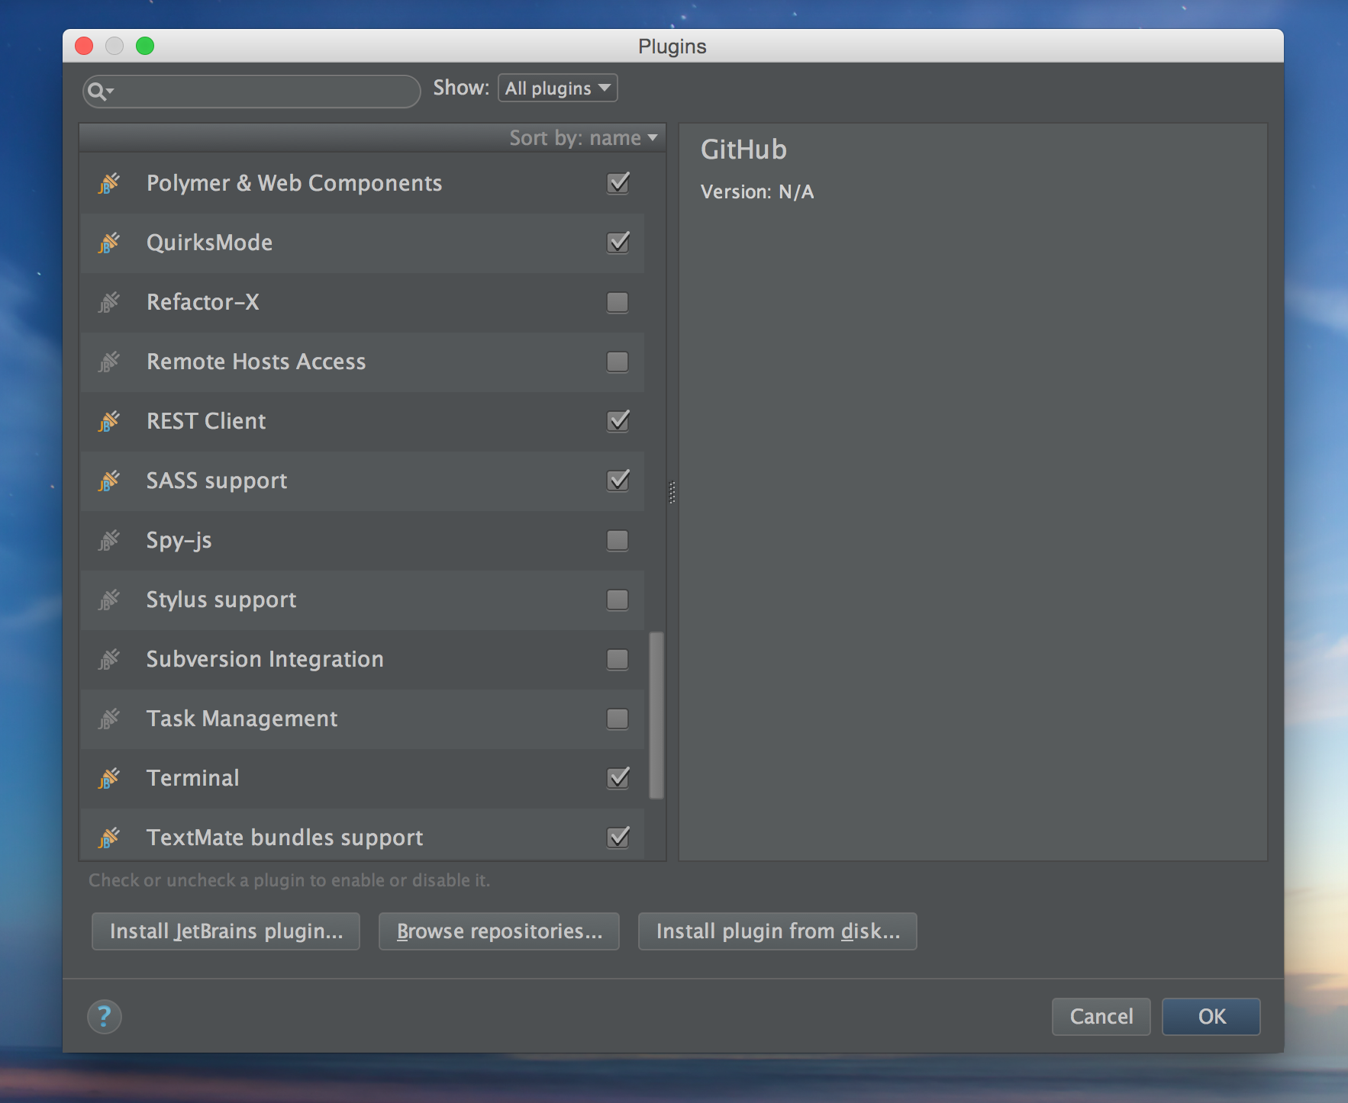

Slide 9
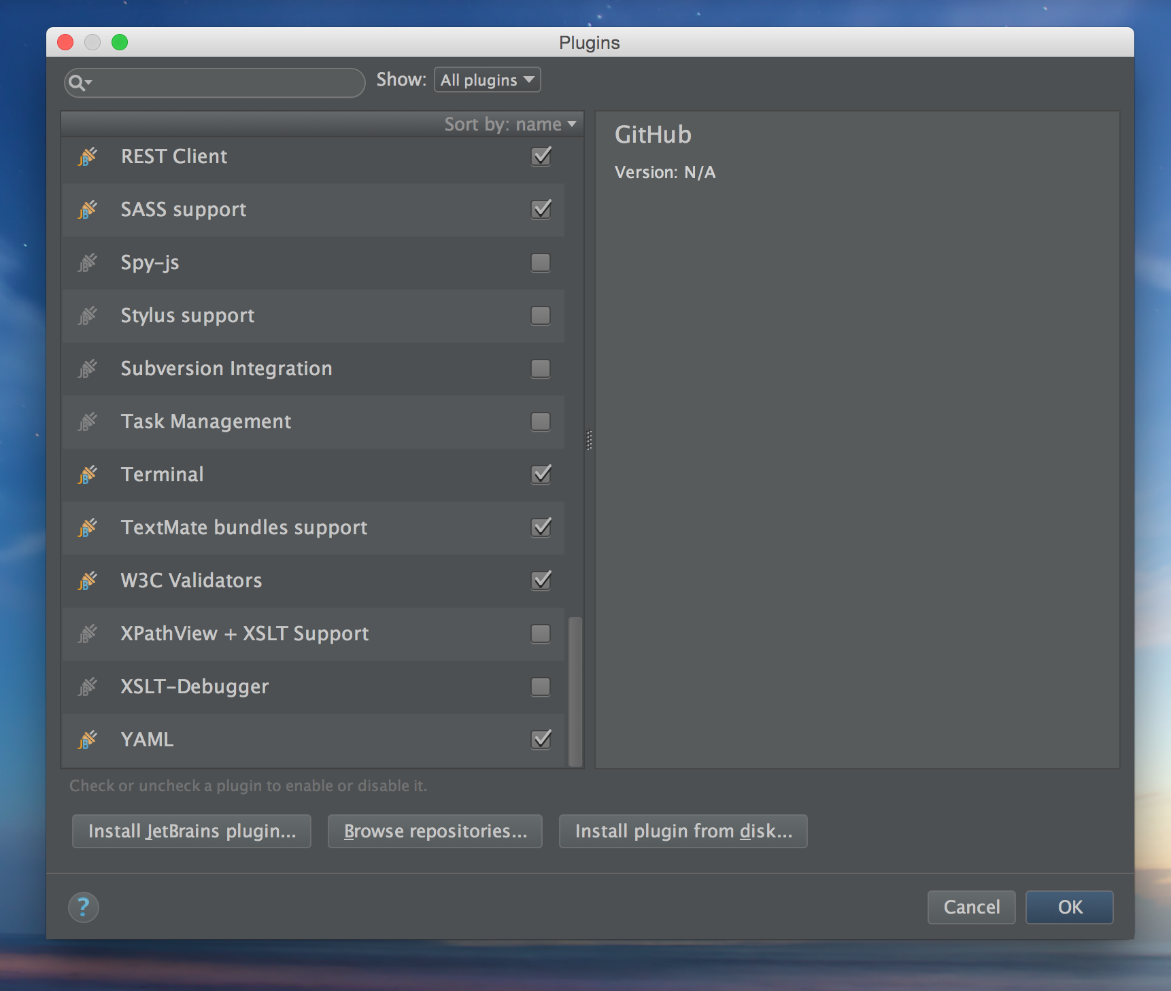

Slide 10
webstorm golang plugin
https://plugins.jetbrains.com/plugin/5047?pr=idea

Slide 11
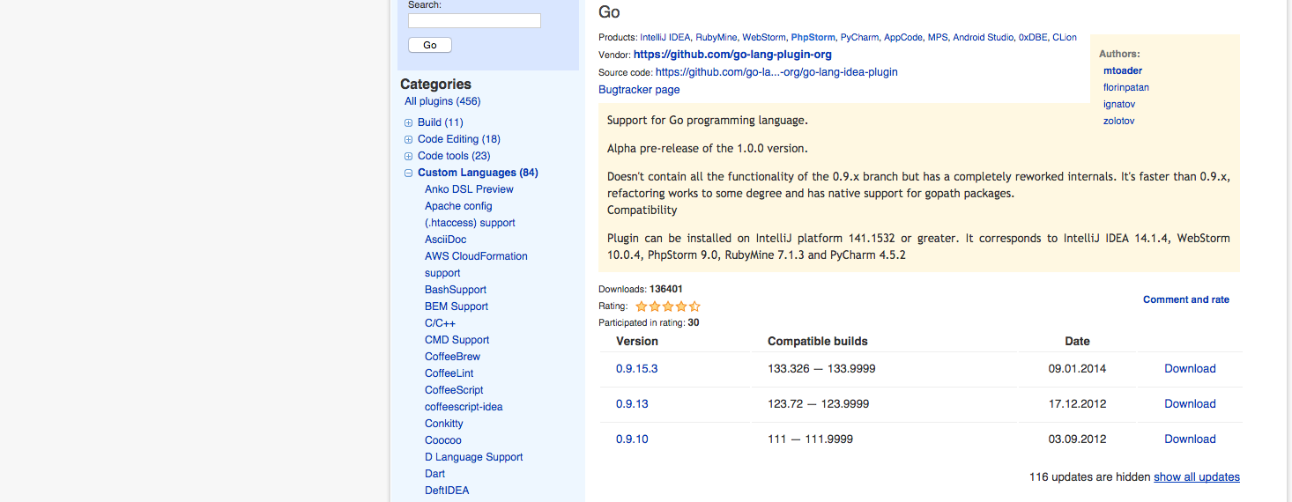

Slide 12
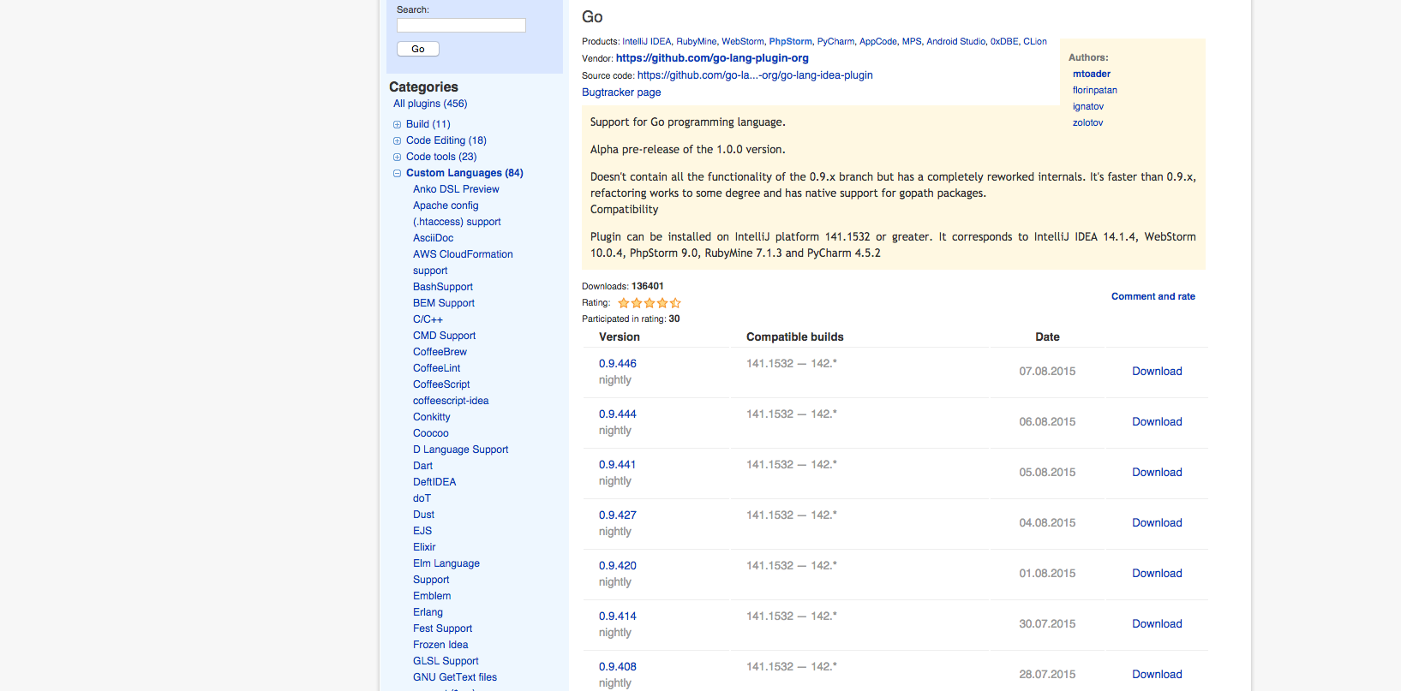

Slide 13


Slide 14
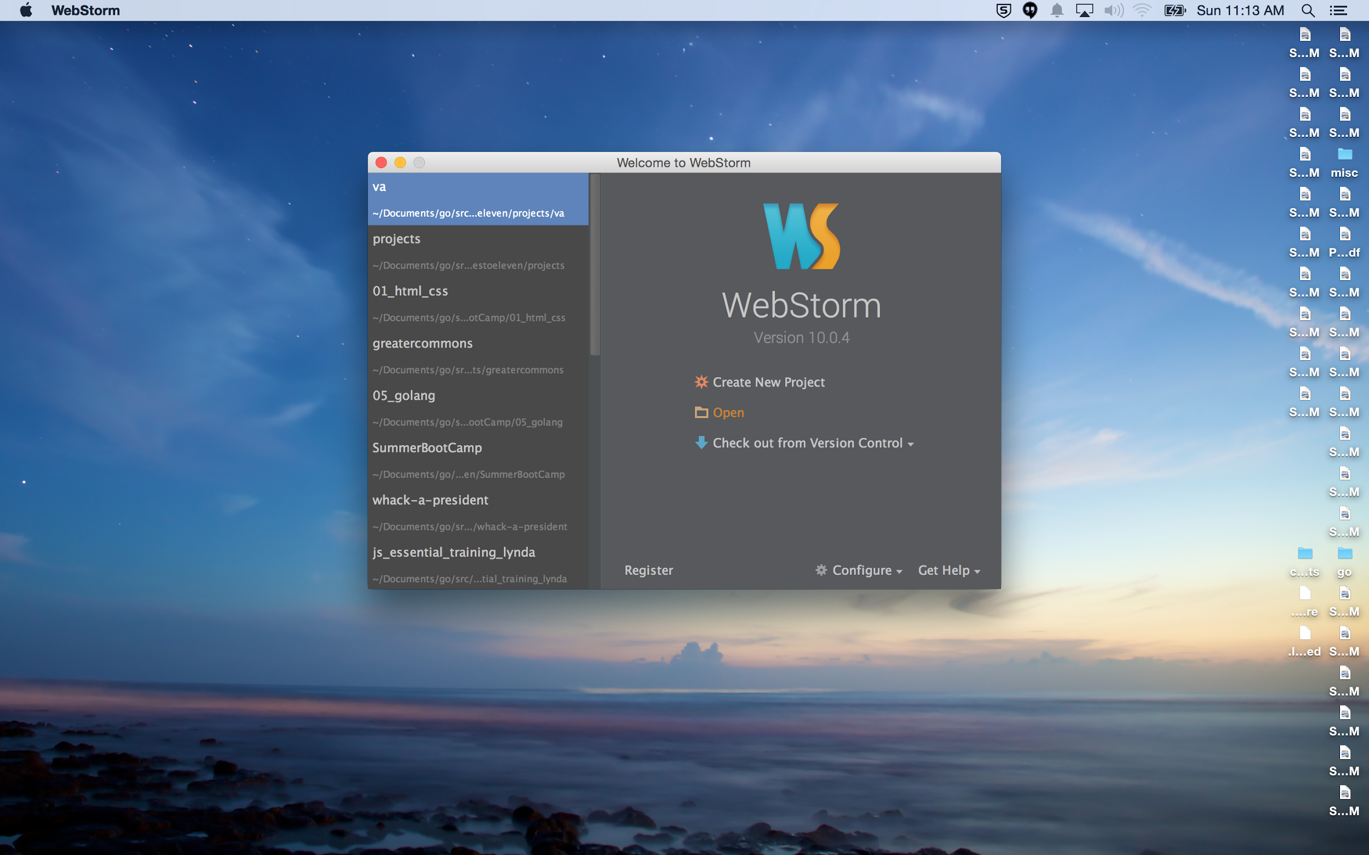

Slide 15
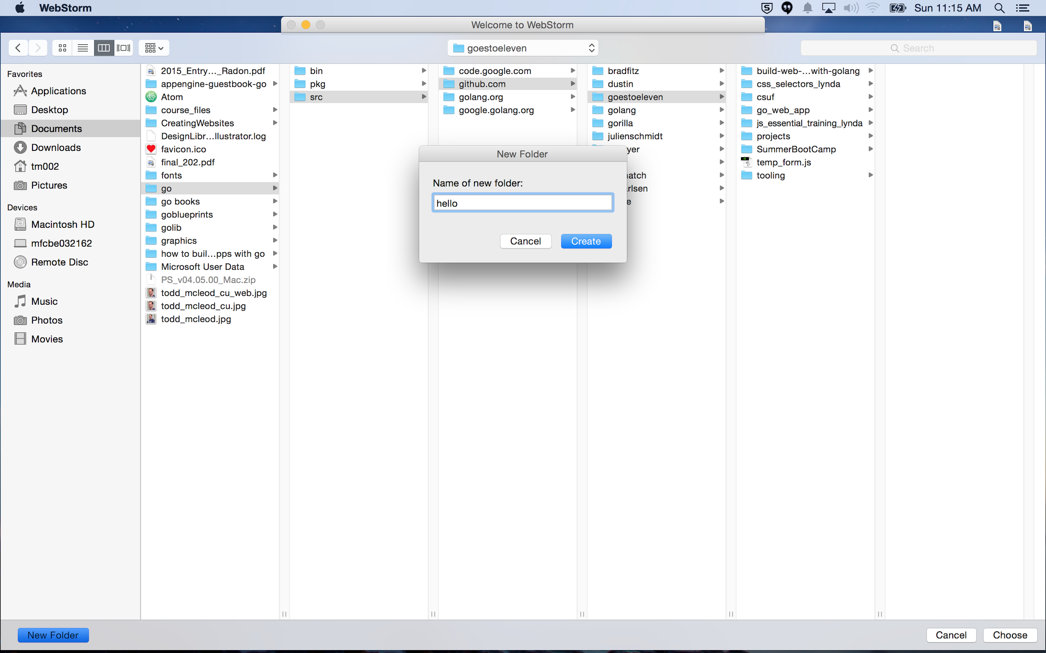

Slide 16
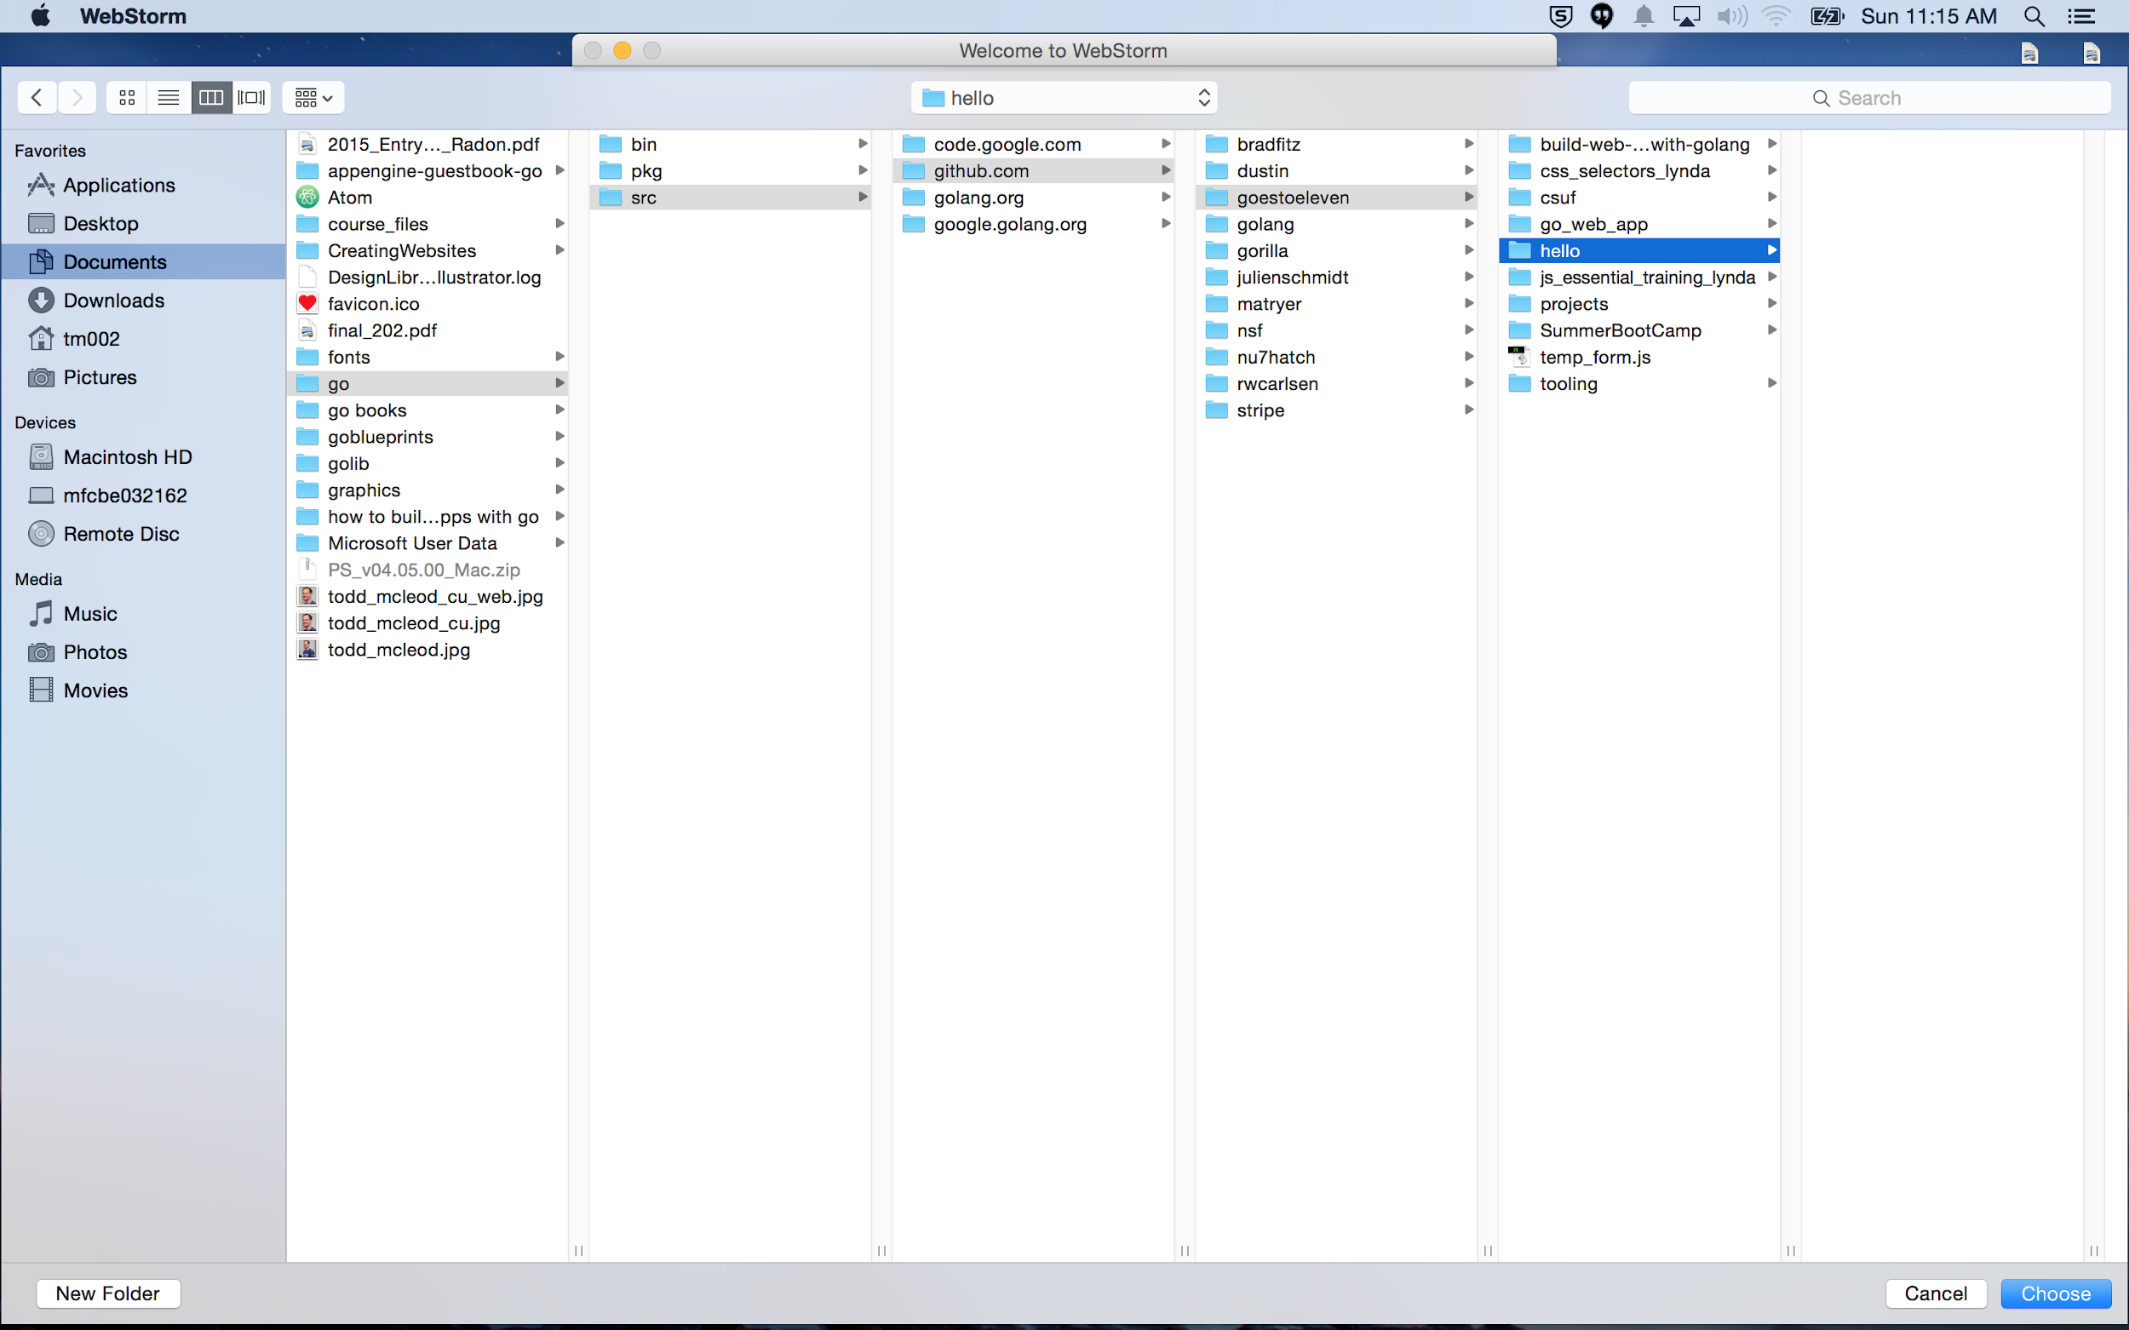

Slide 17
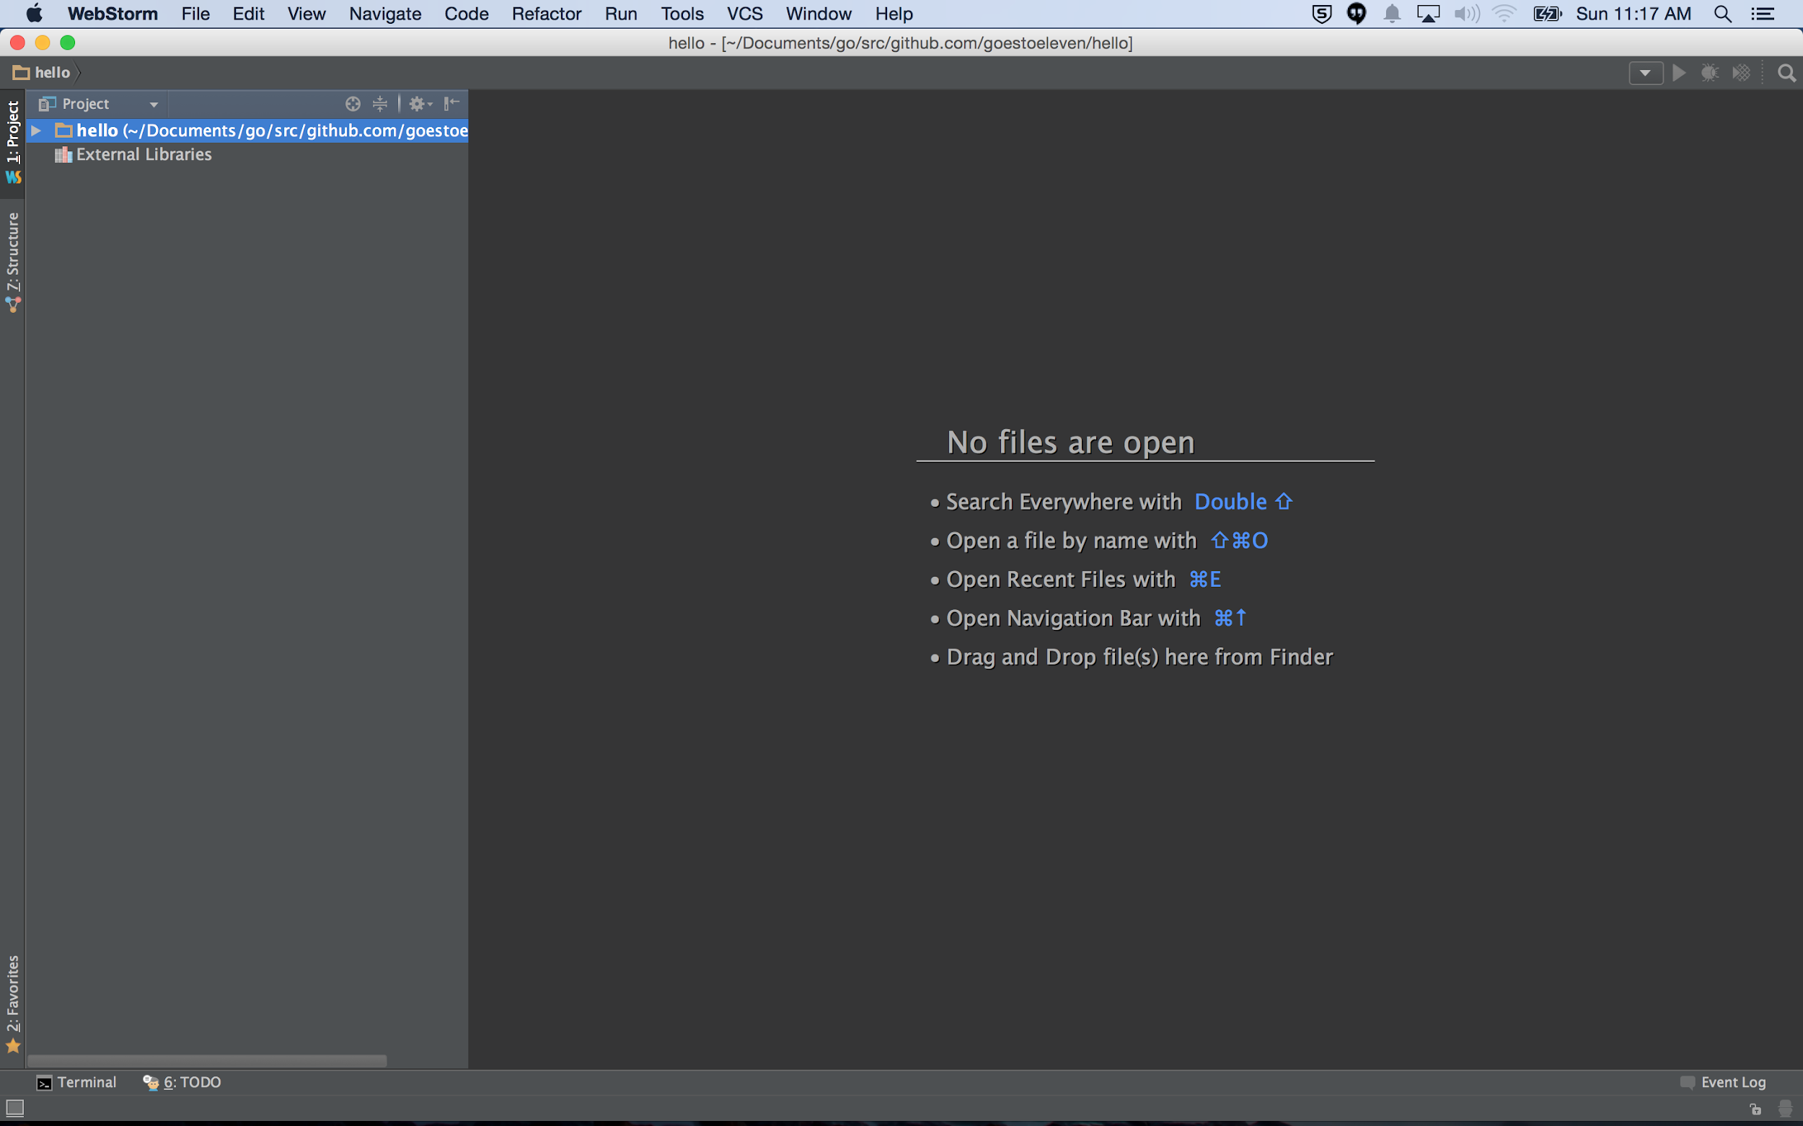

Slide 18
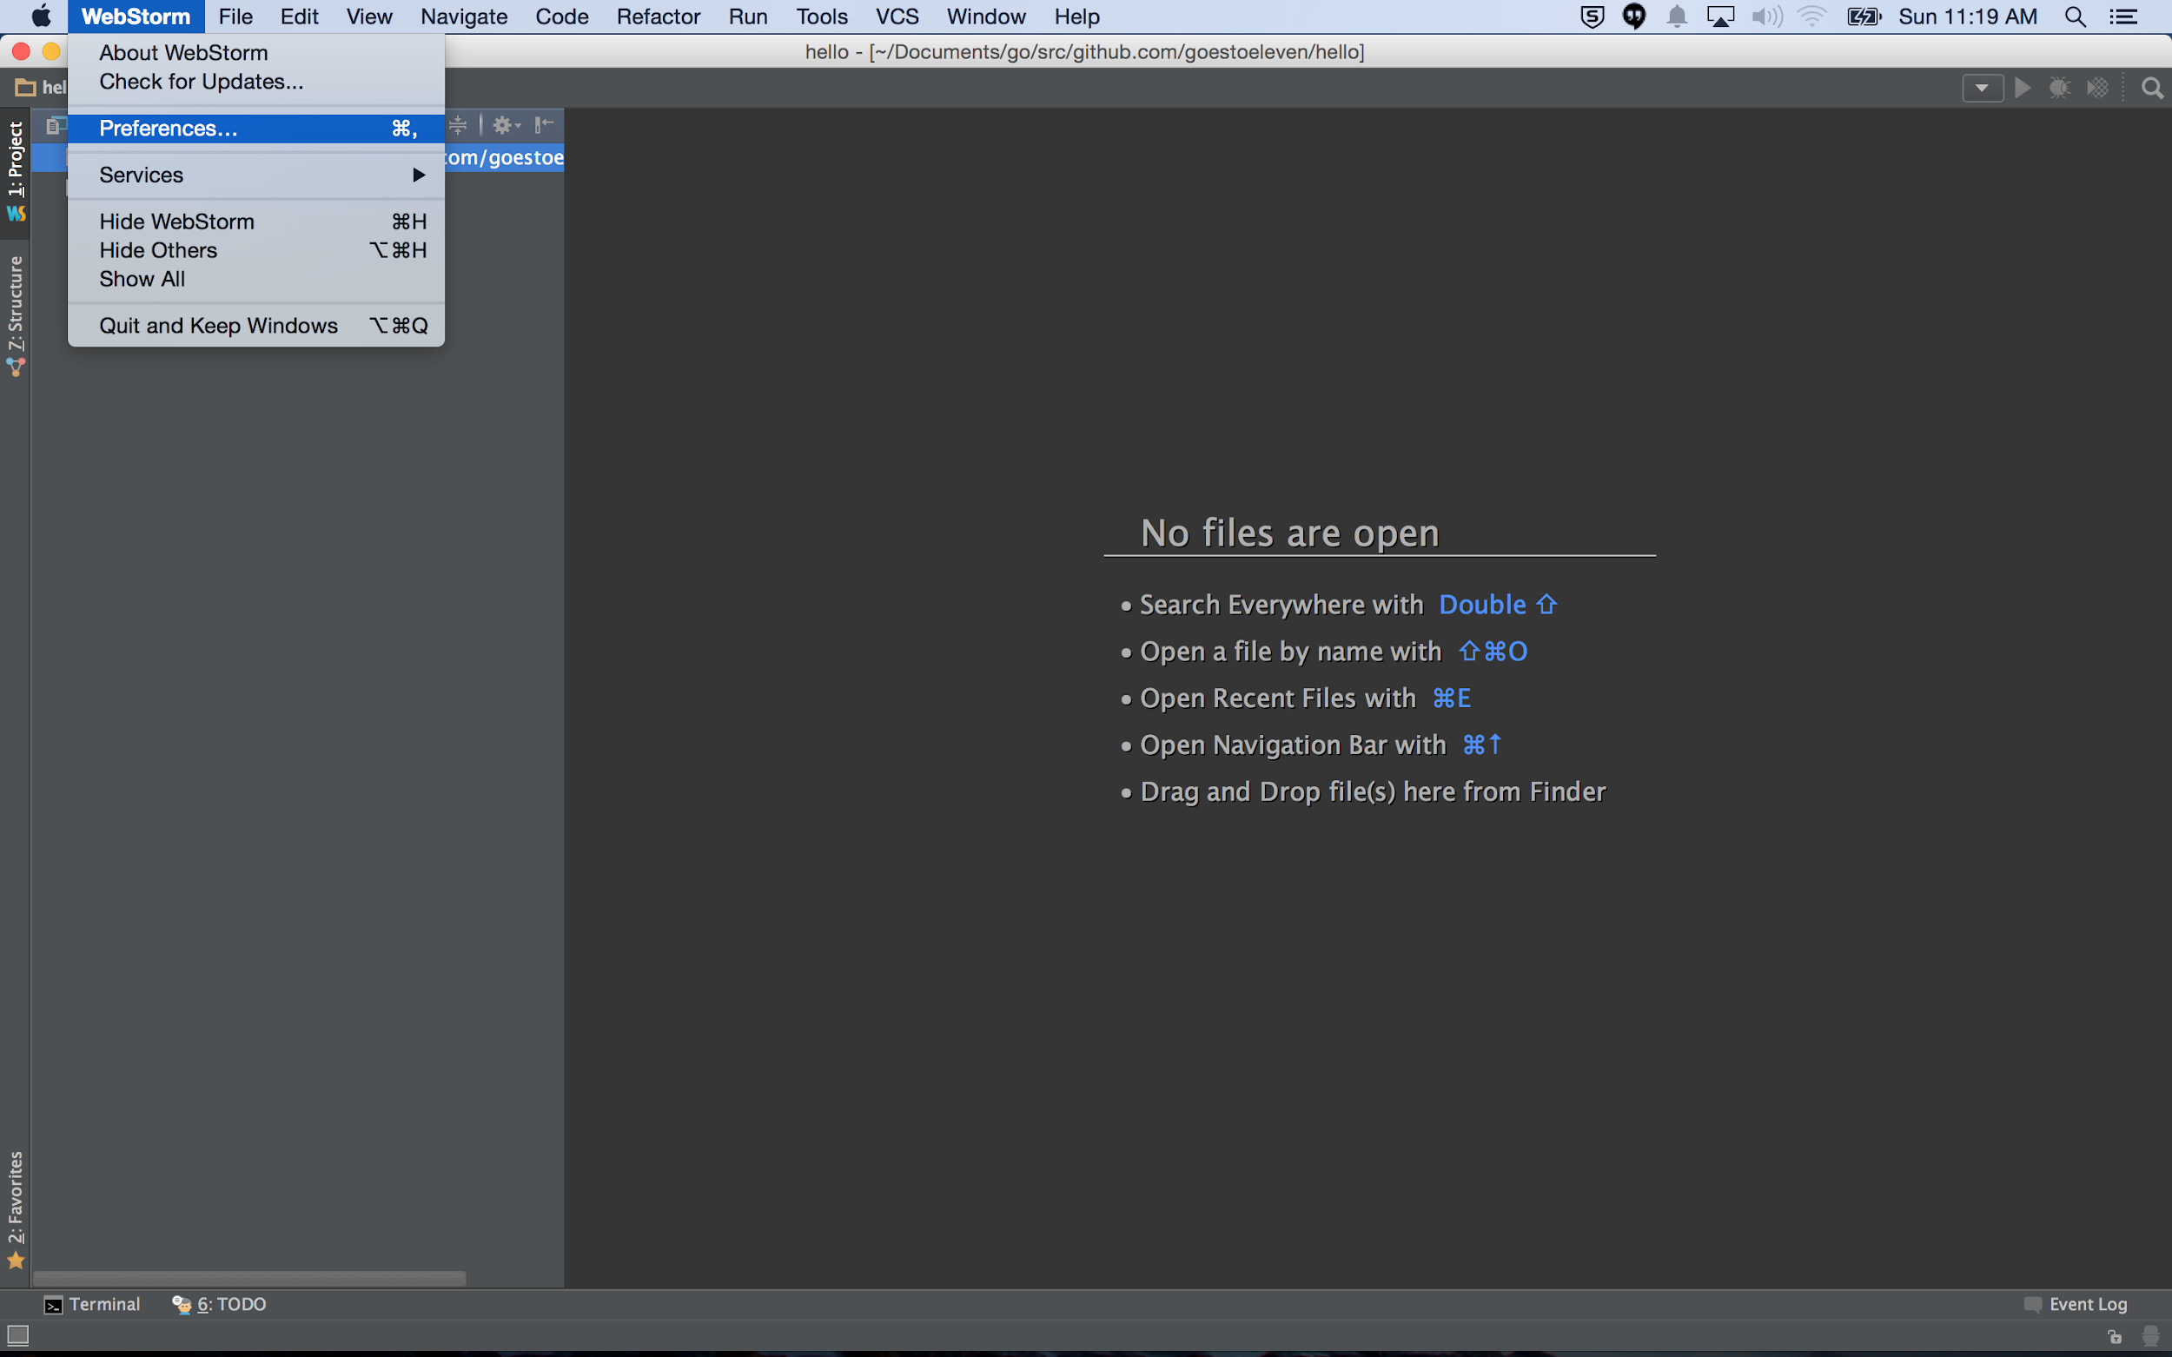

Slide 19
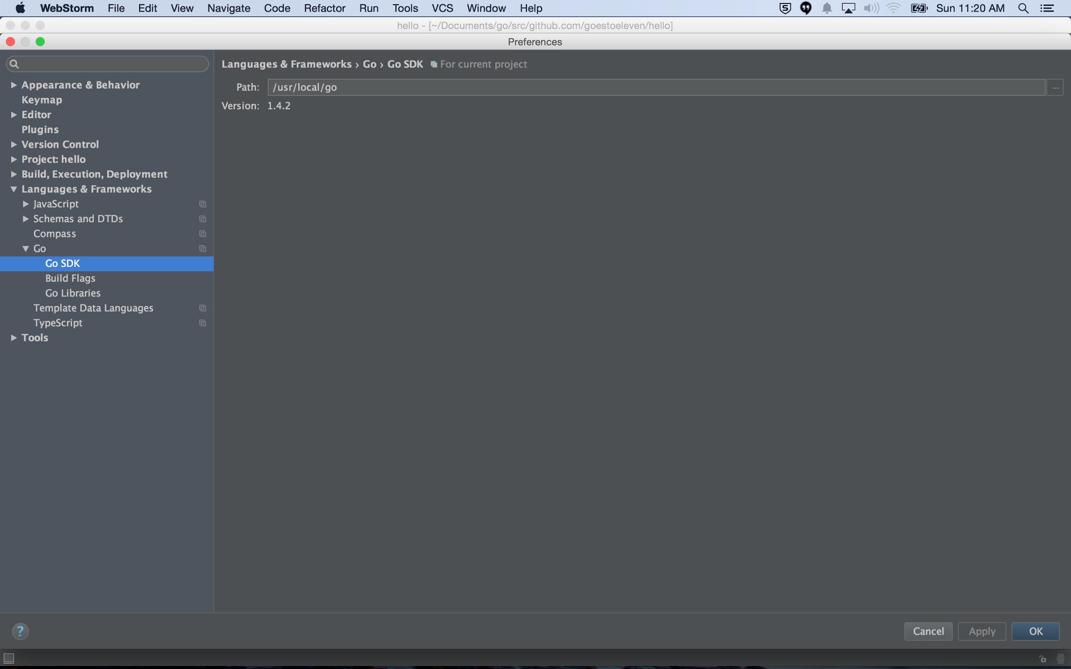

Slide 20
webstorm themes
http://www.ideacolorthemes.org/home/

Slide 21
install theme
http://www.ideacolorthemes.org/help/

Slide 22
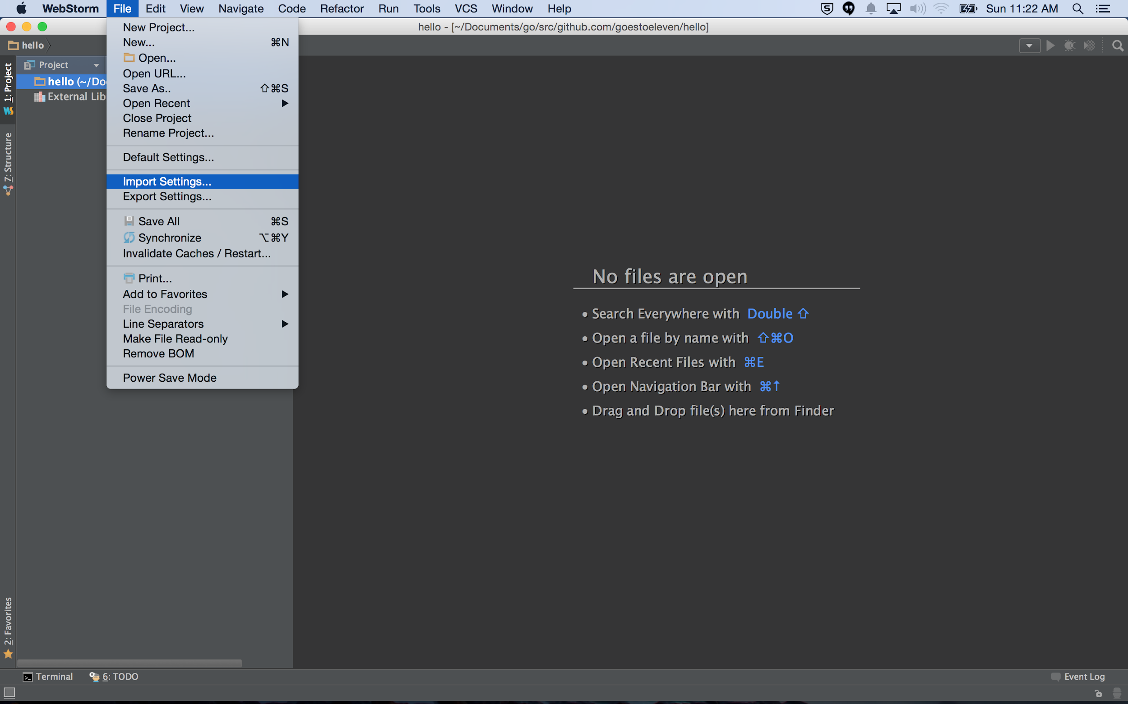

Slide 23
live edit
https://www.jetbrains.com/webstorm/help/live-edit.html

Slide 24
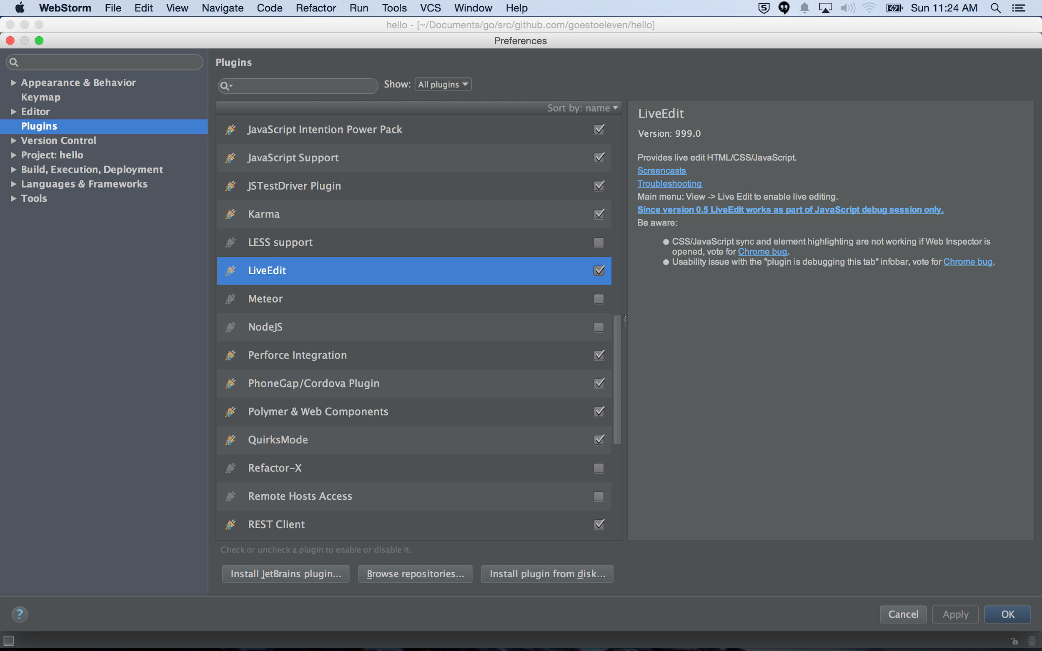

Slide 25
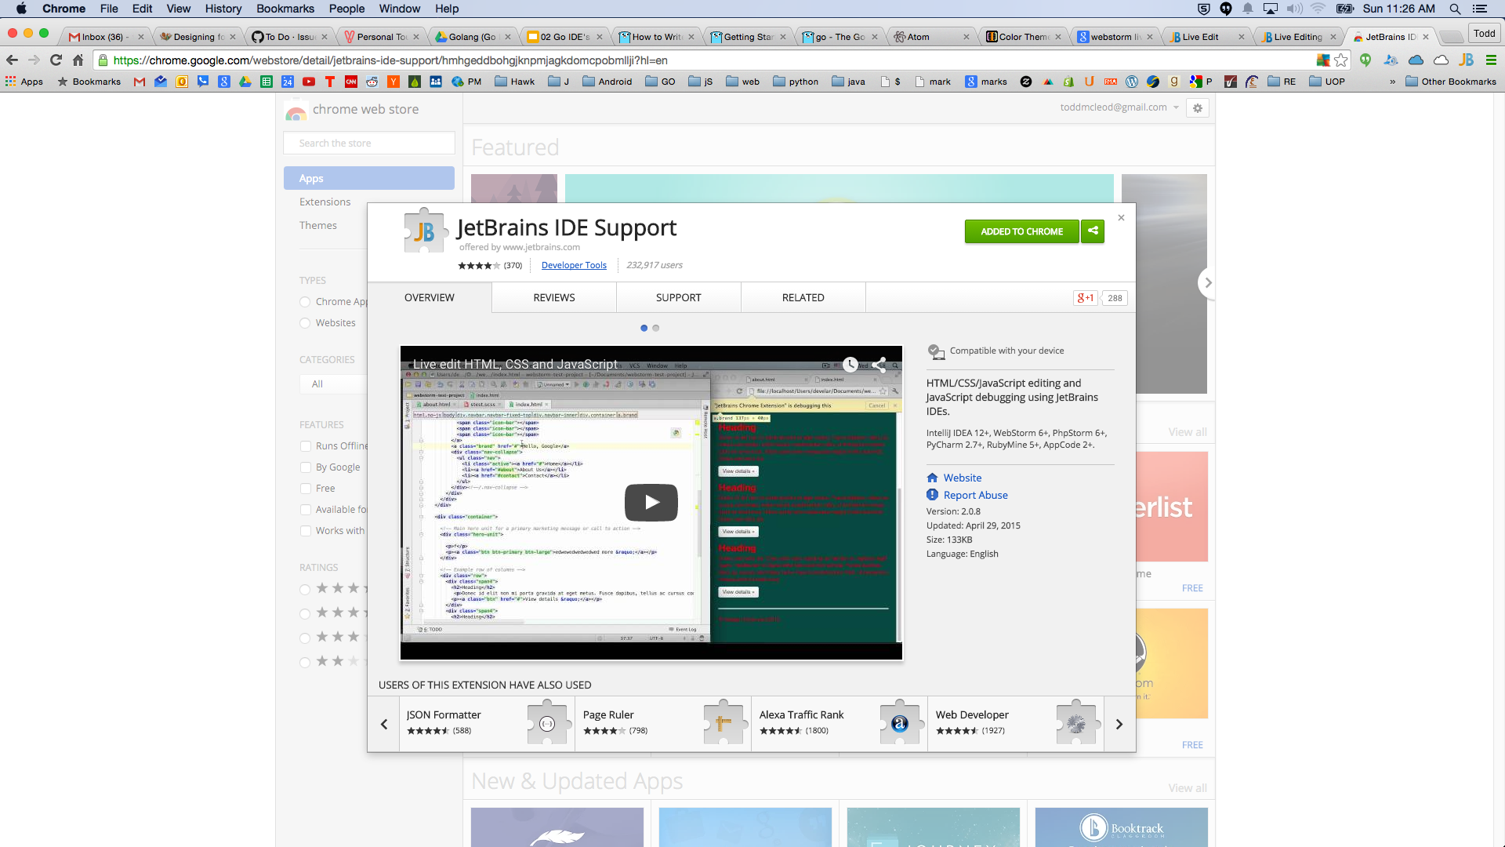

Slide 26
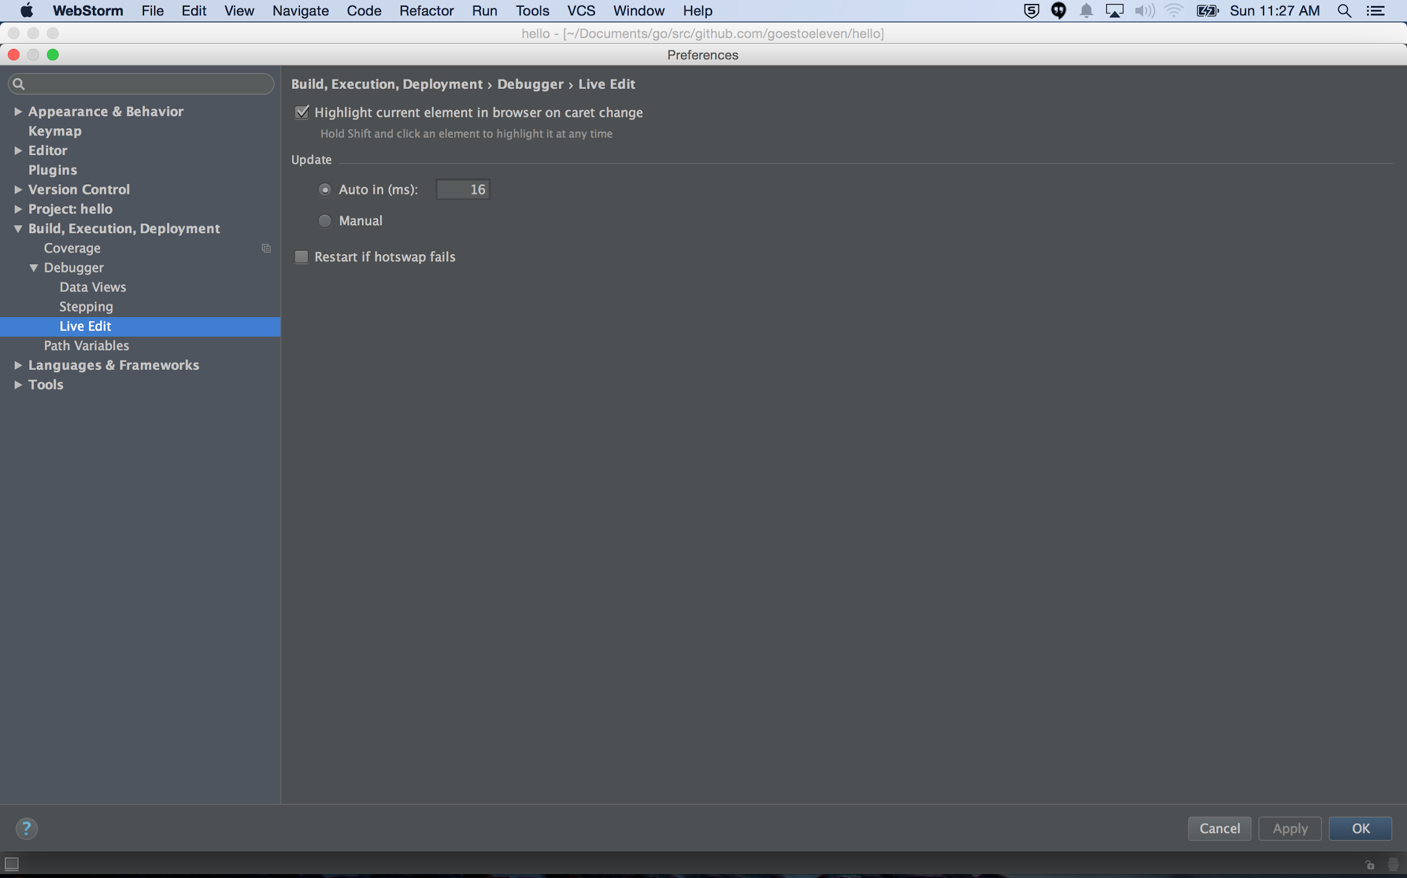

Slide 27
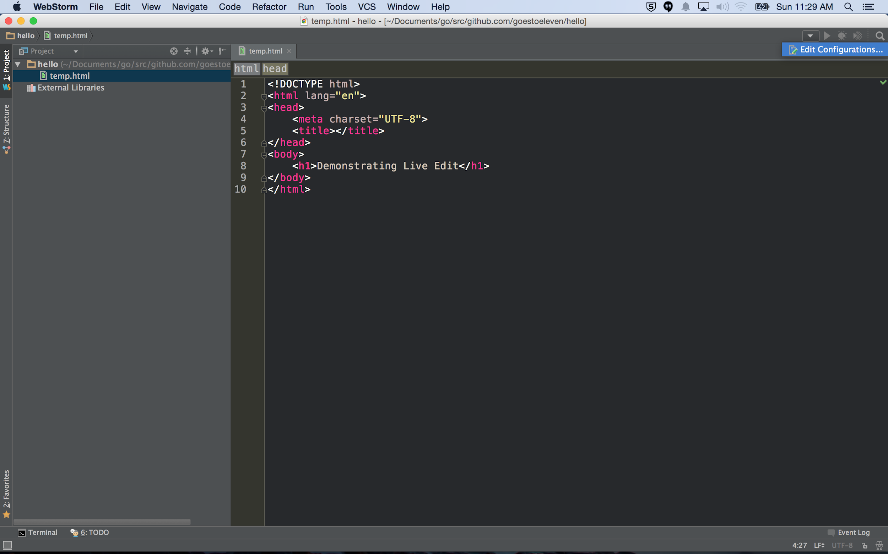

Slide 28
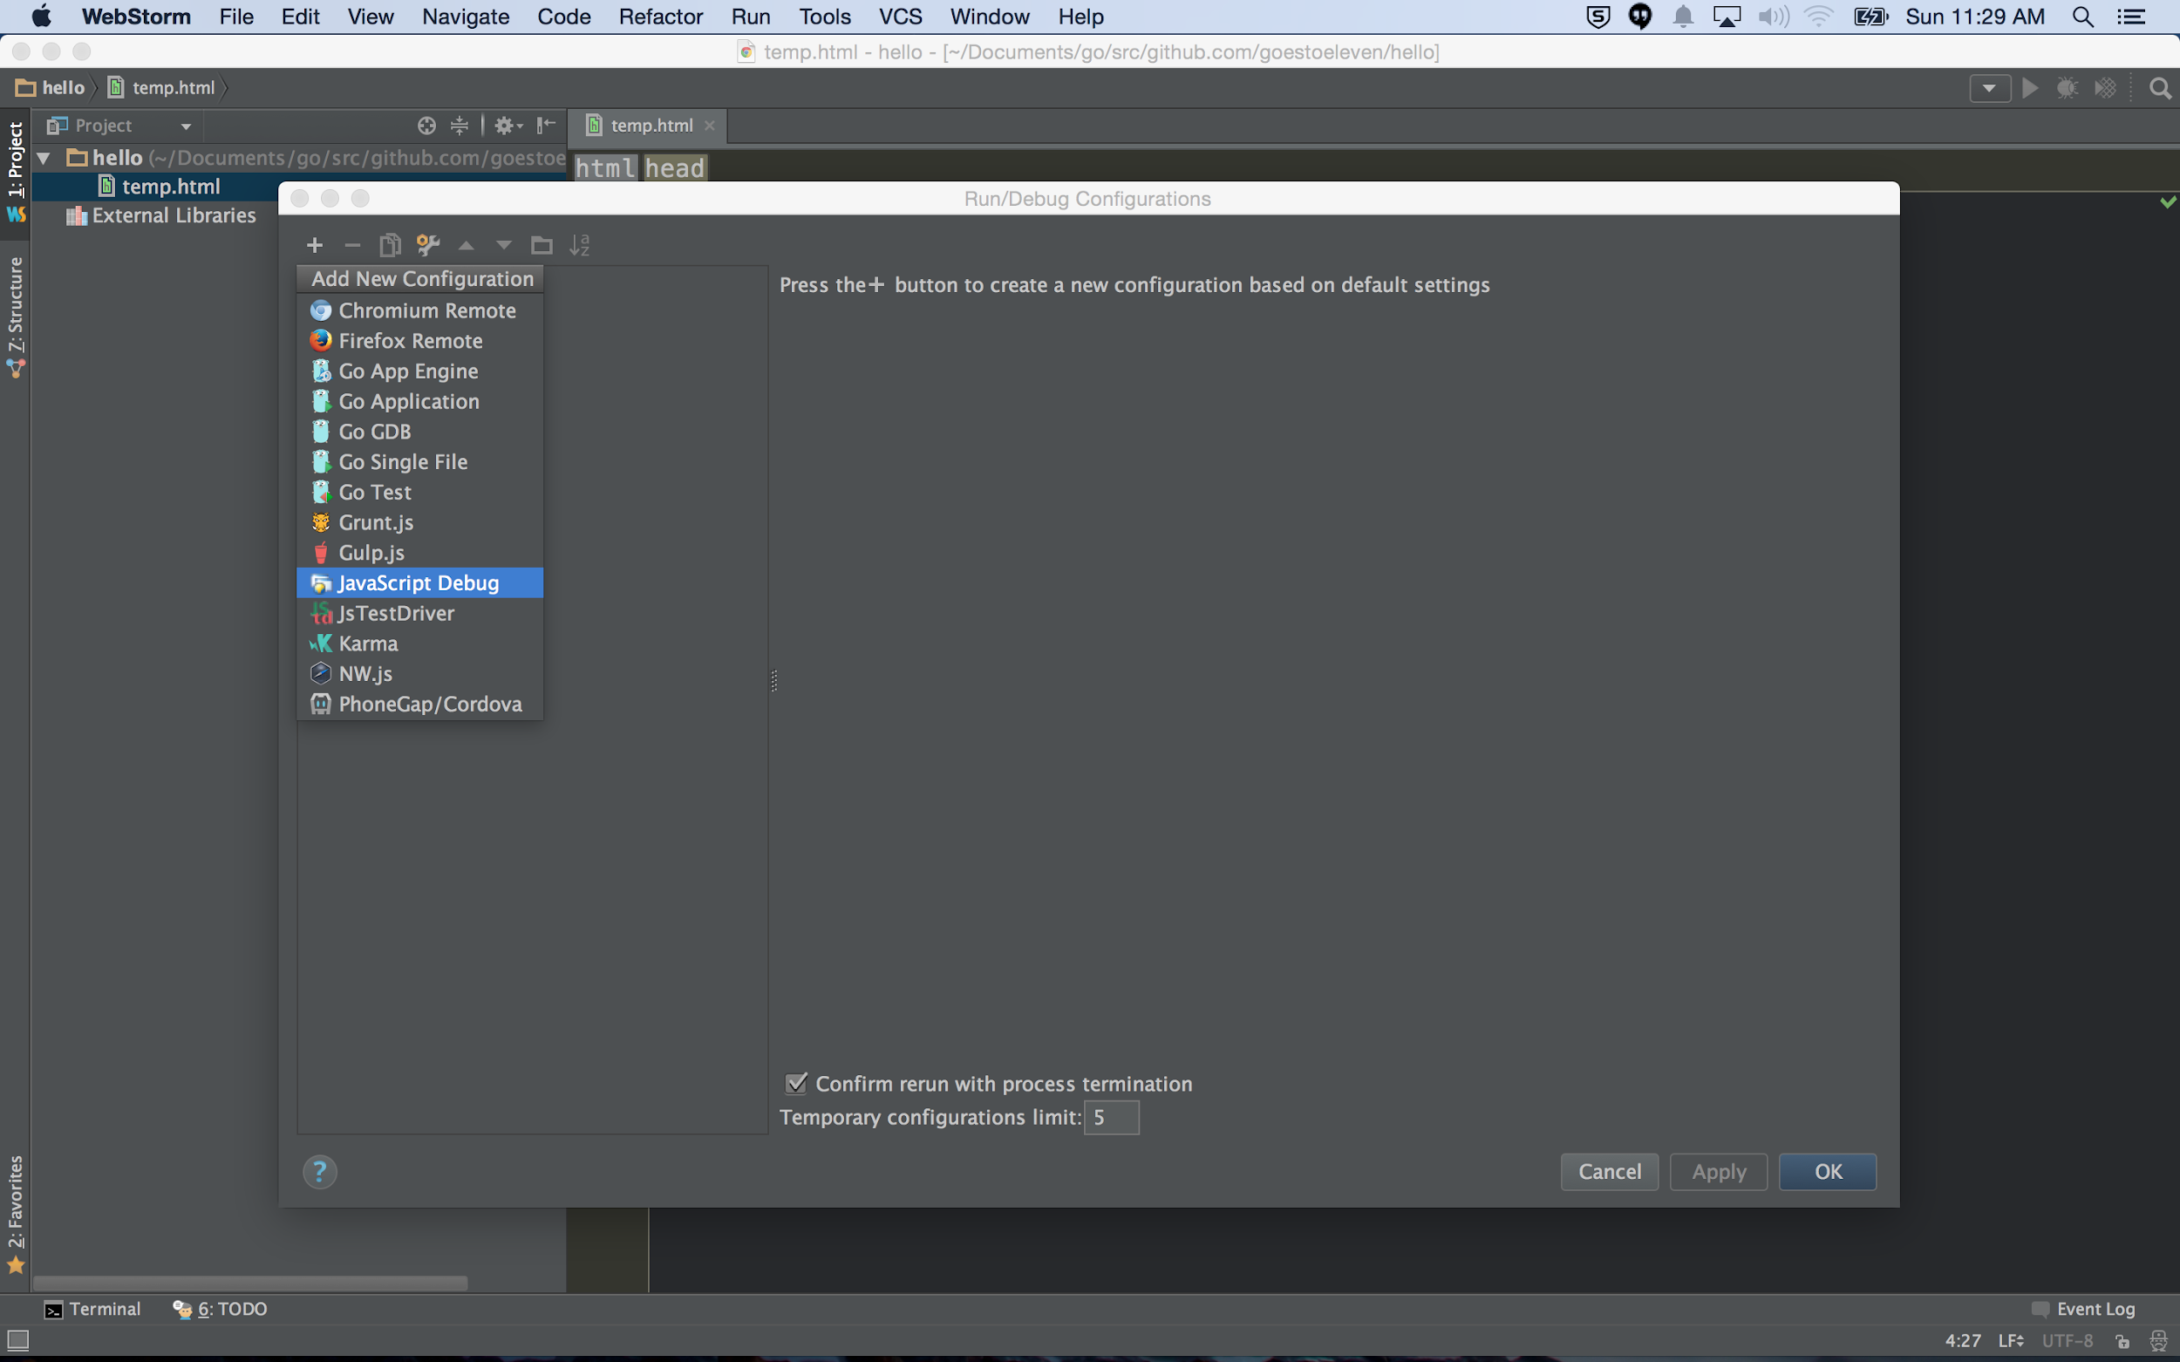

Slide 29
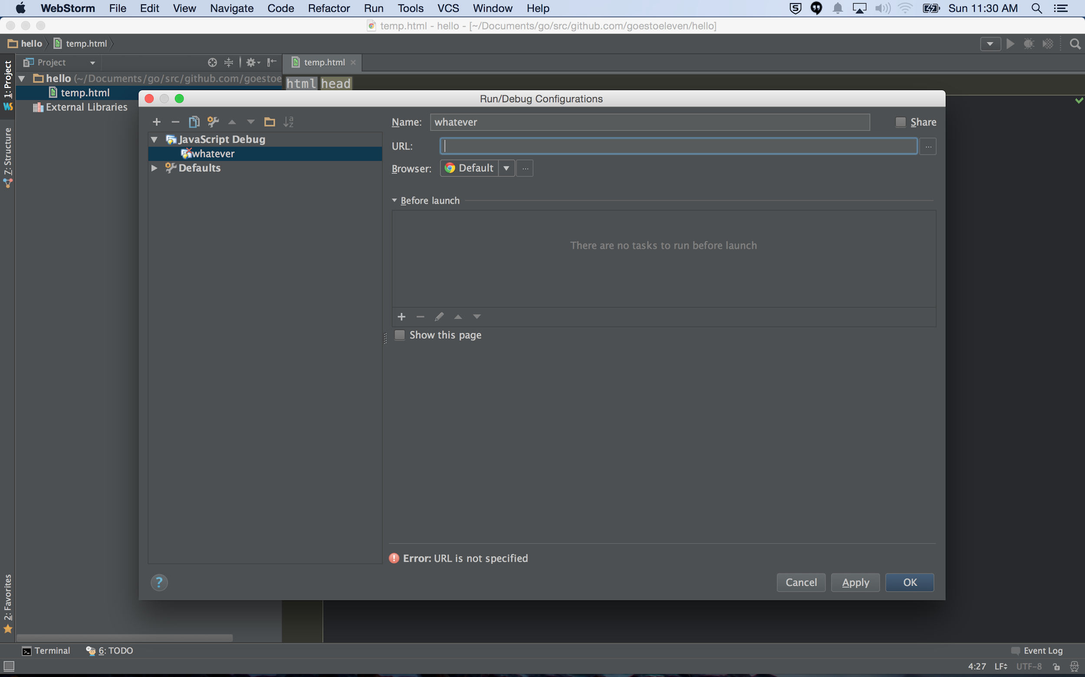

Slide 30
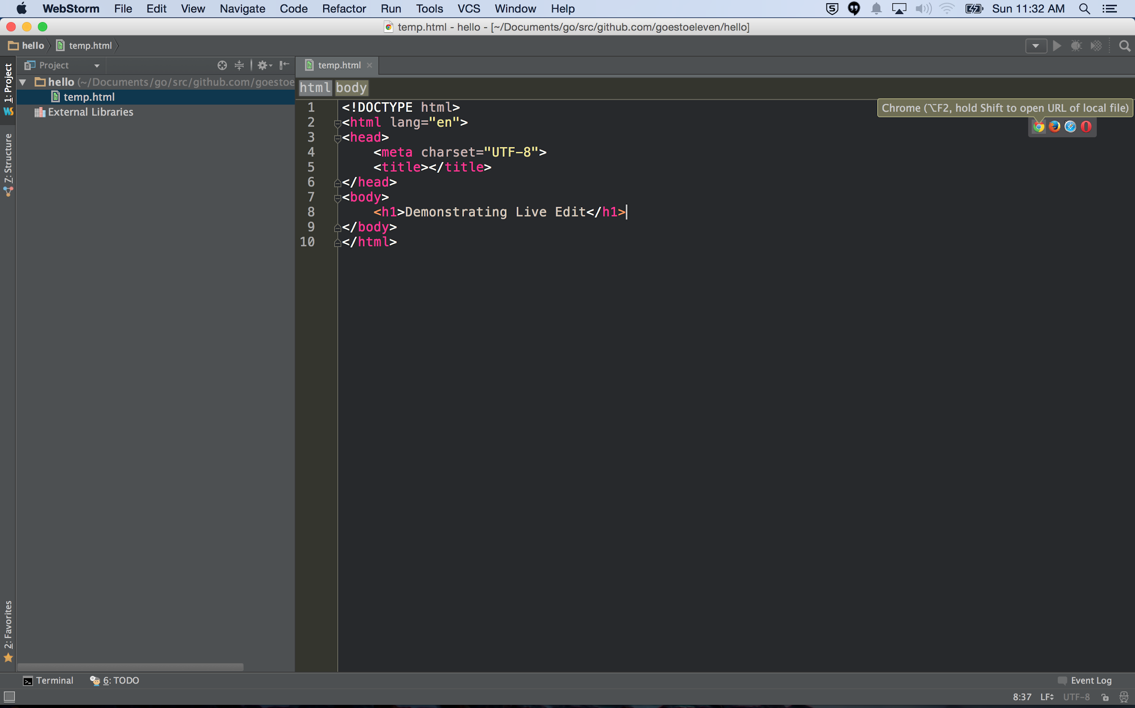

Slide 31
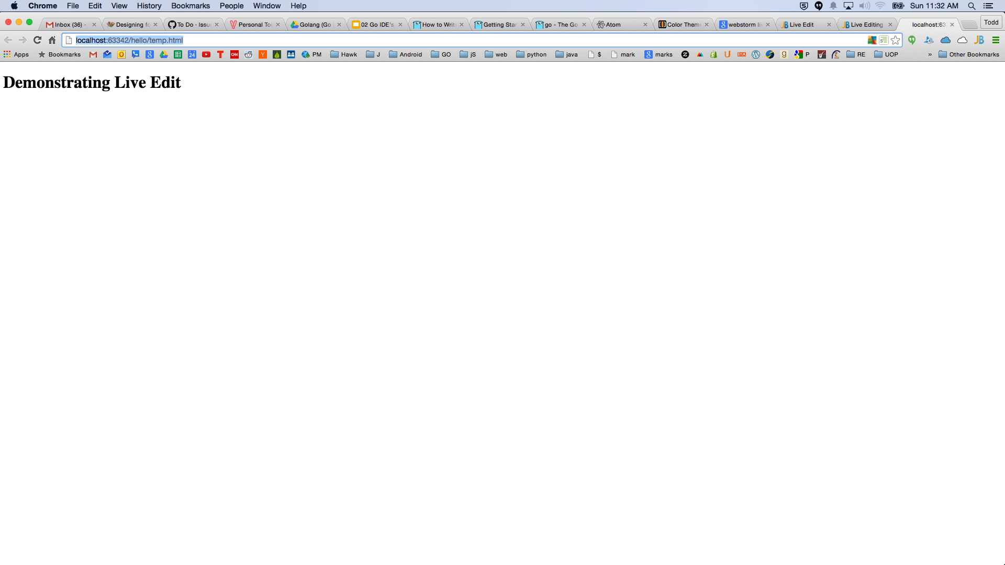

Slide 32
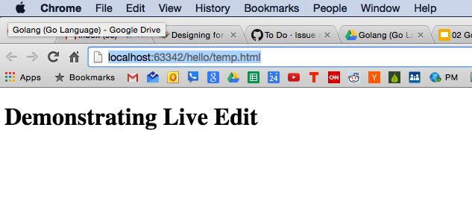

Slide 33
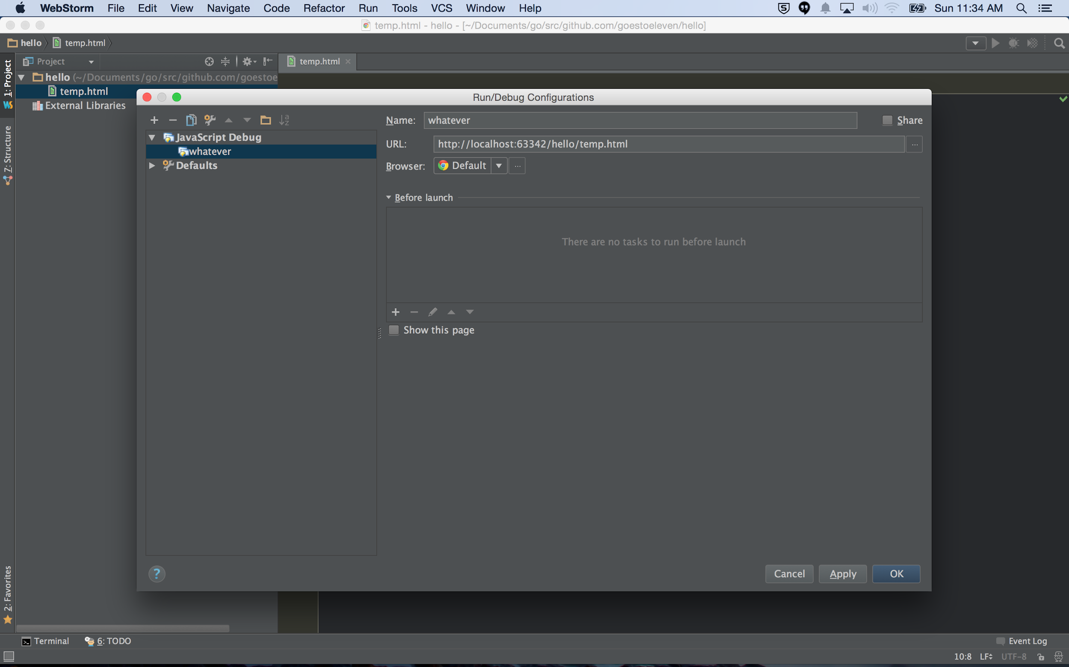

Slide 34
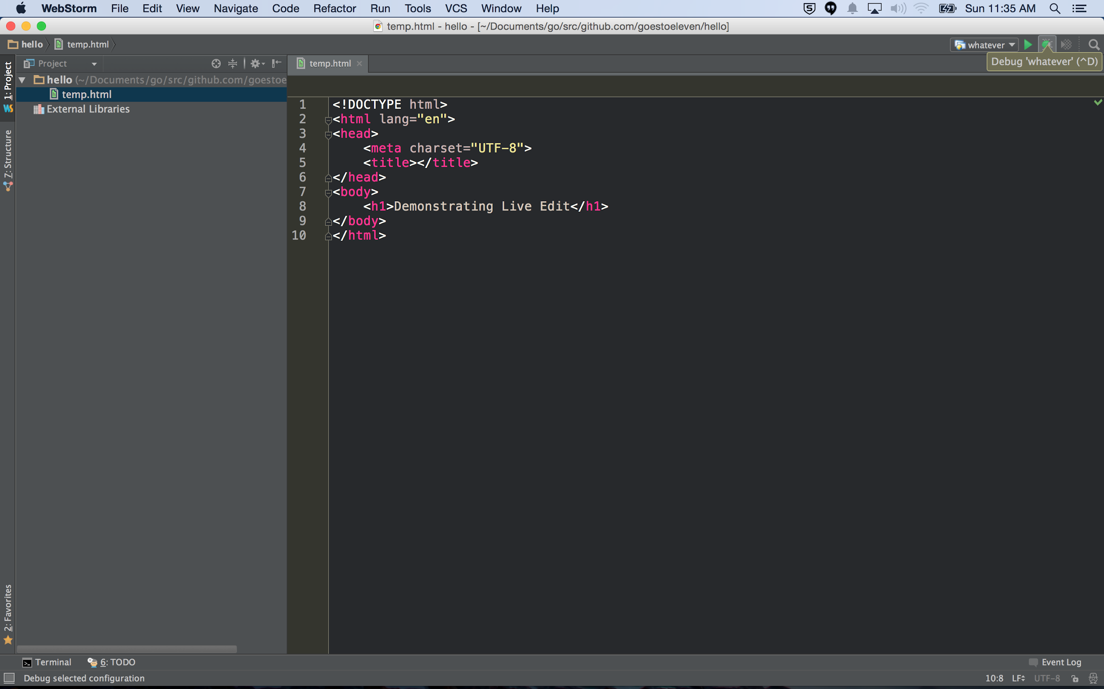

Slide 35
keymap

Slide 36
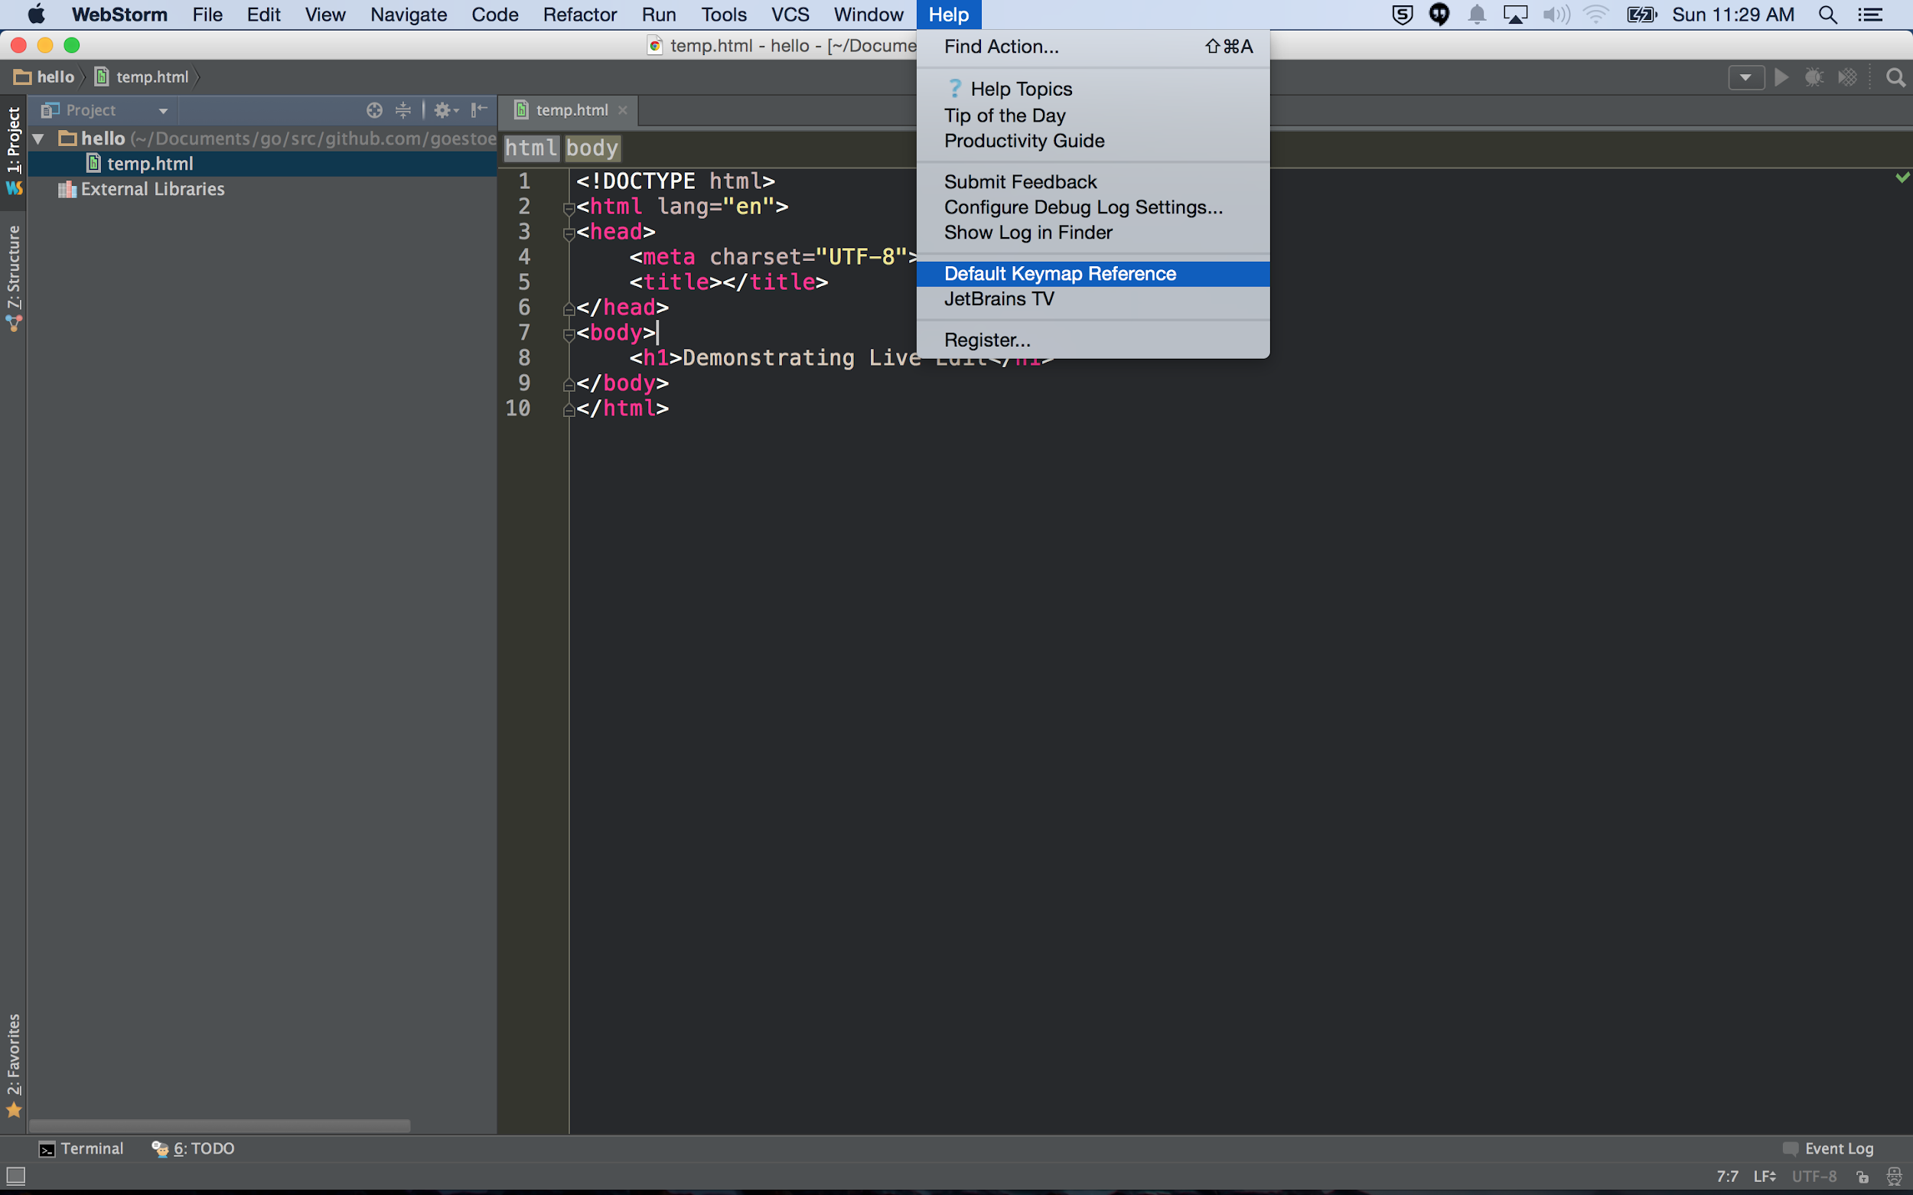

Slide 37
I have found helpful ...

Slide 38
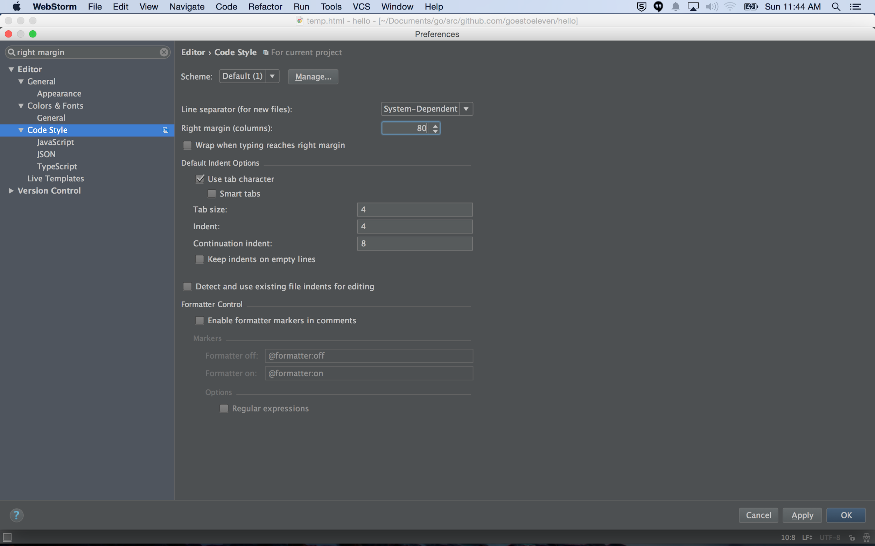

Slide 39
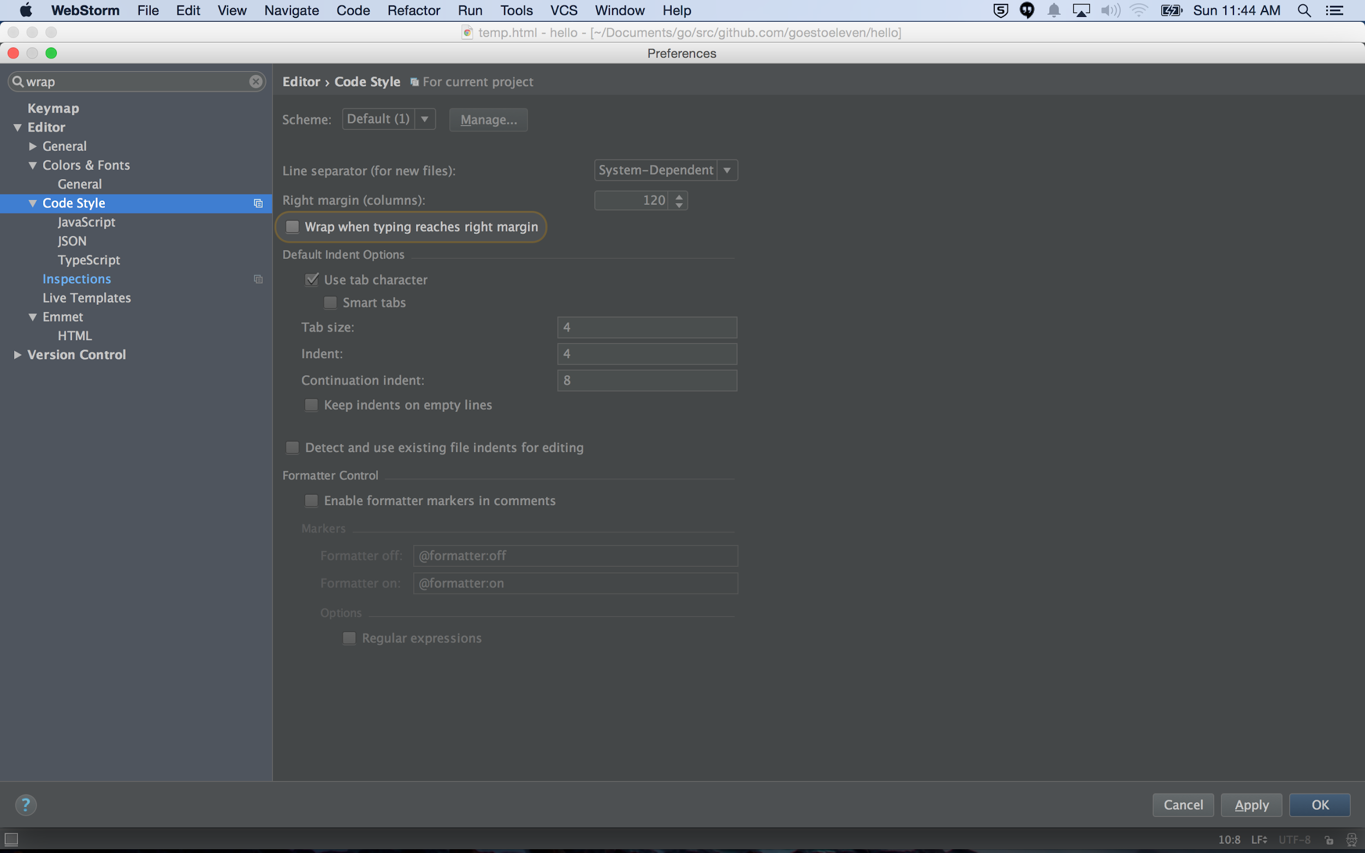

Slide 40
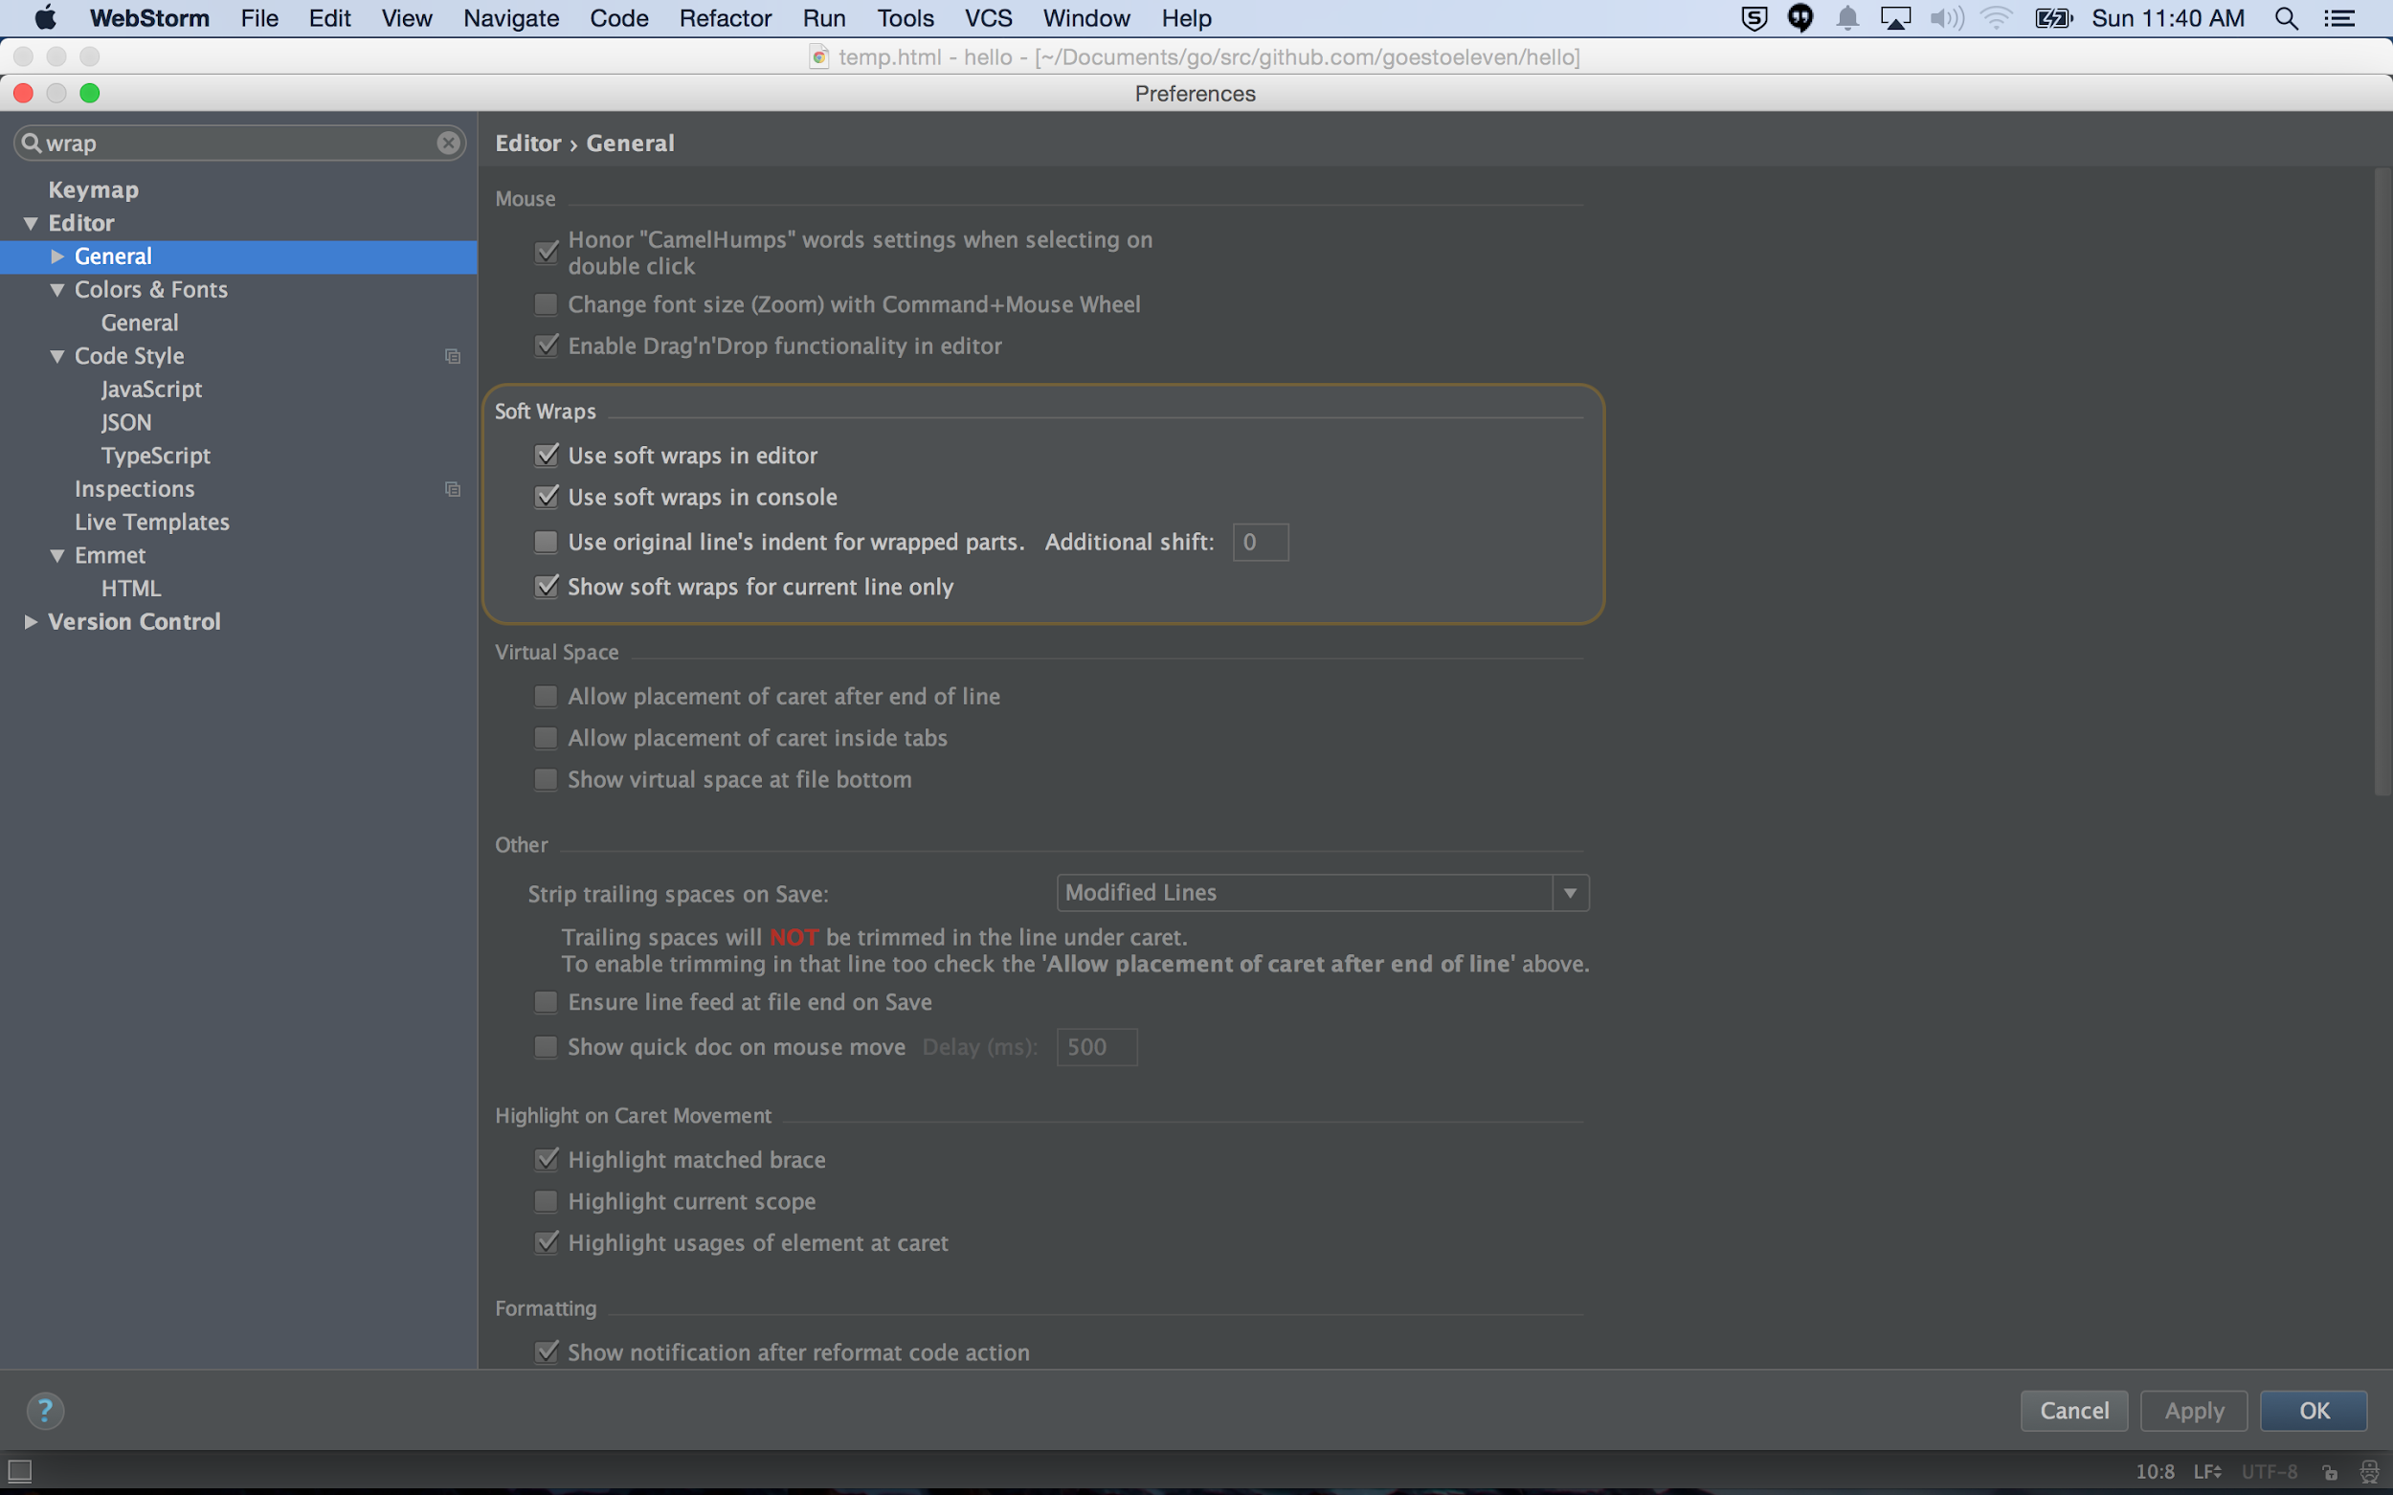

Slide 41
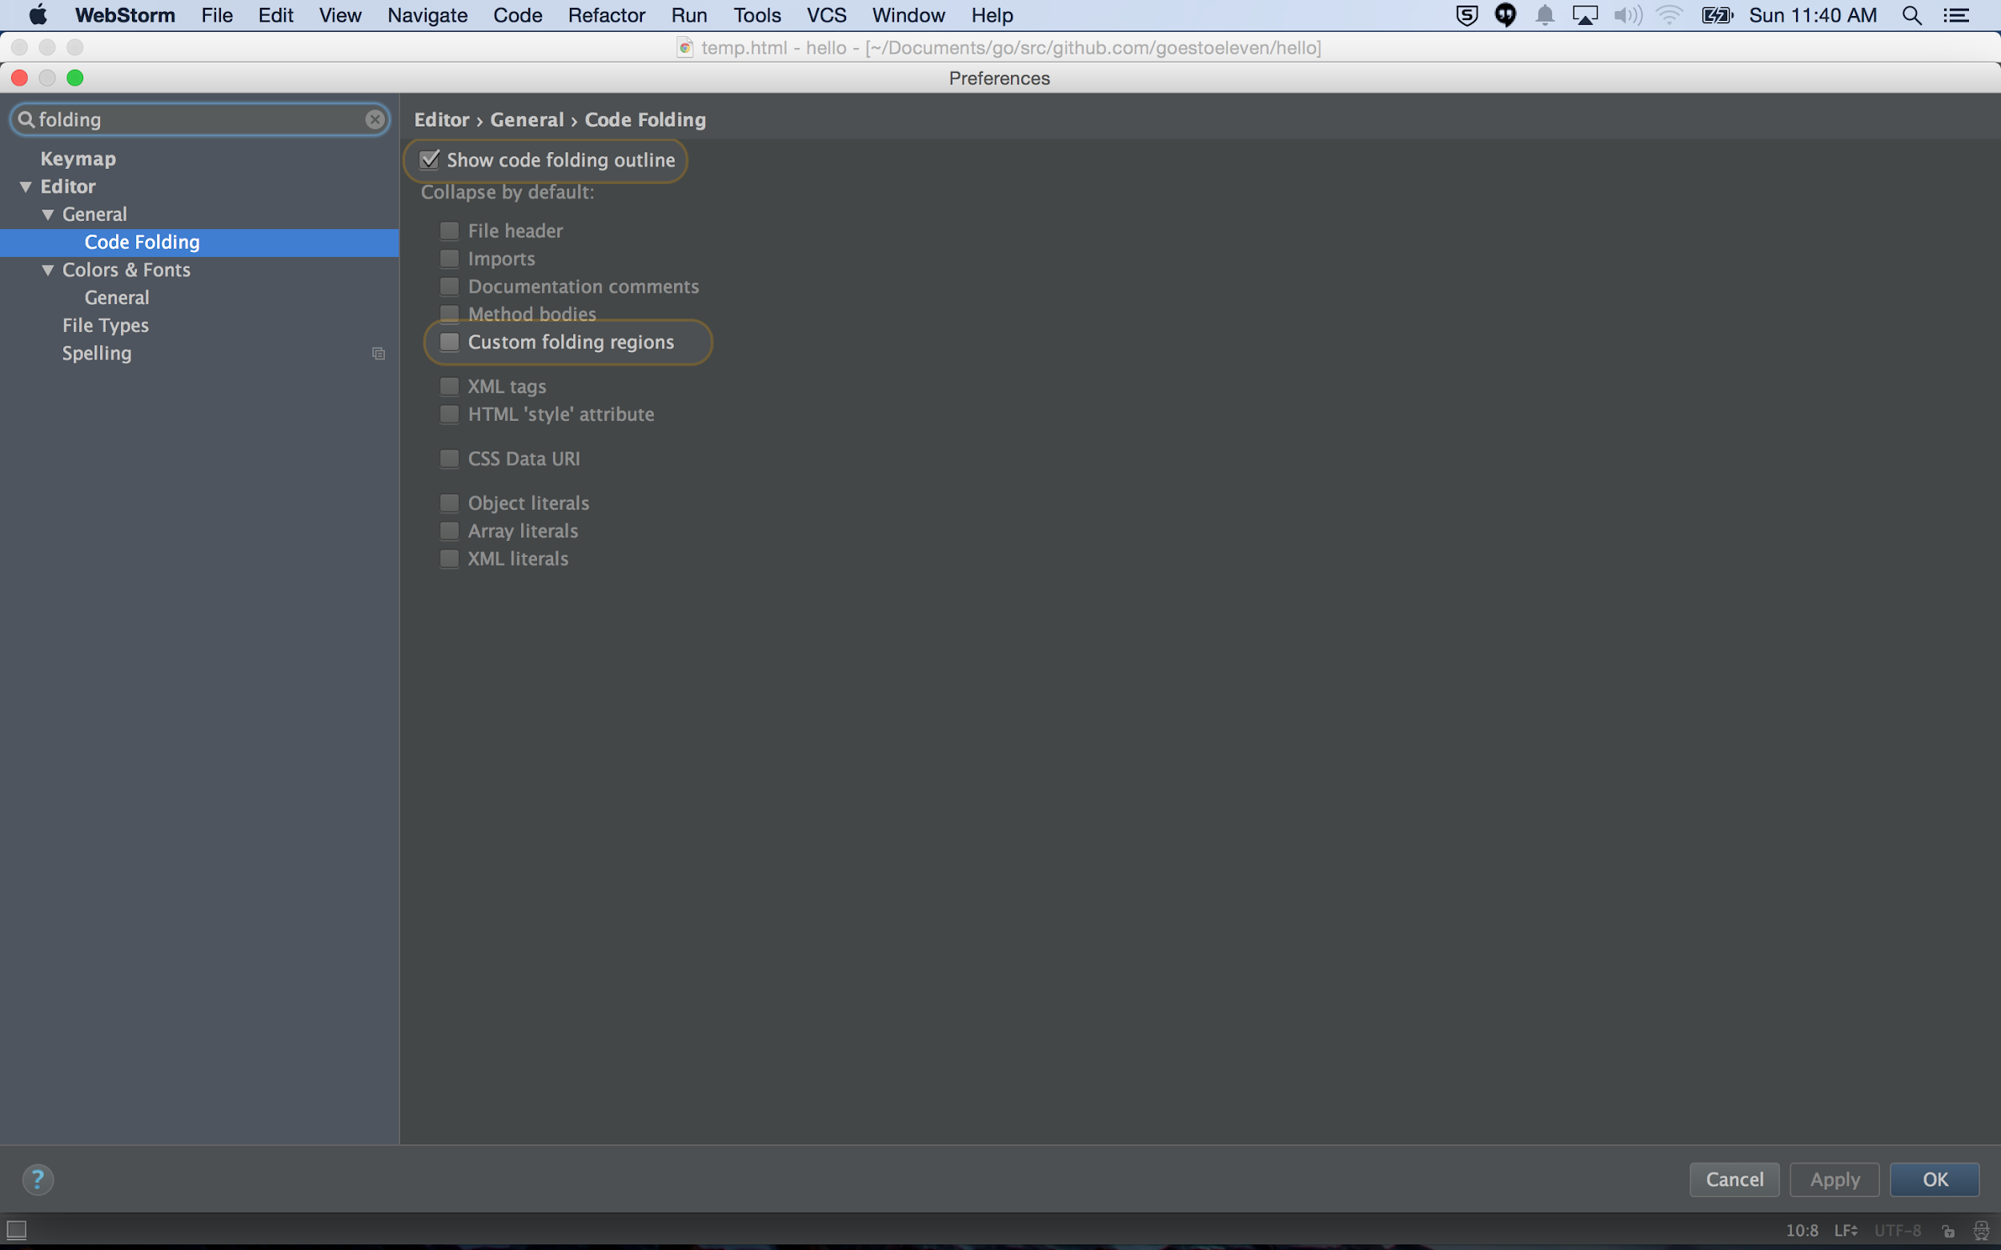

Slide 42
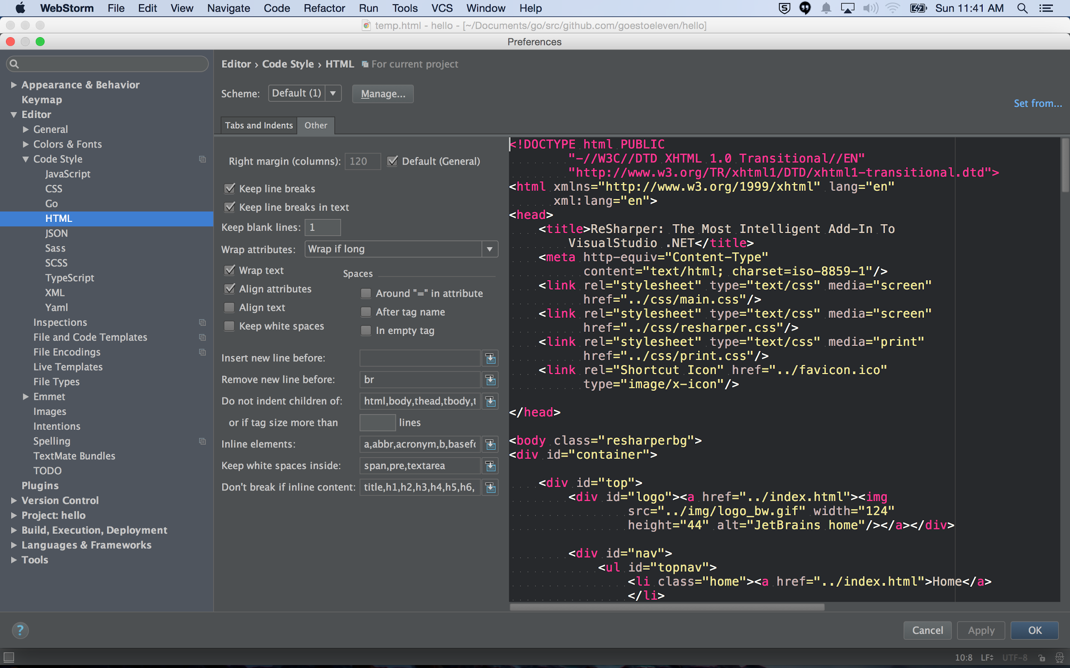

Slide 43
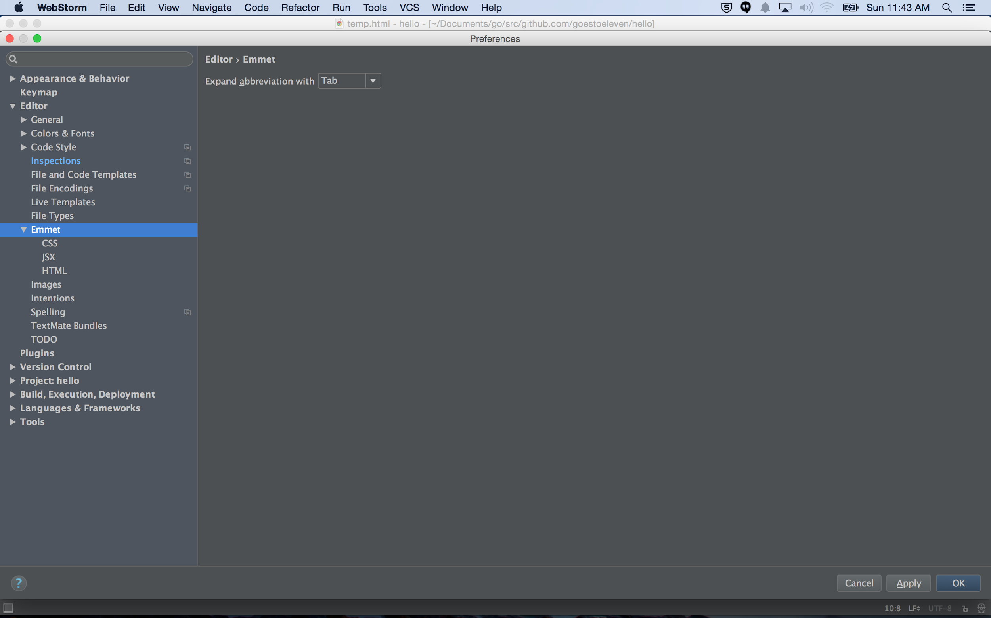

Slide 44
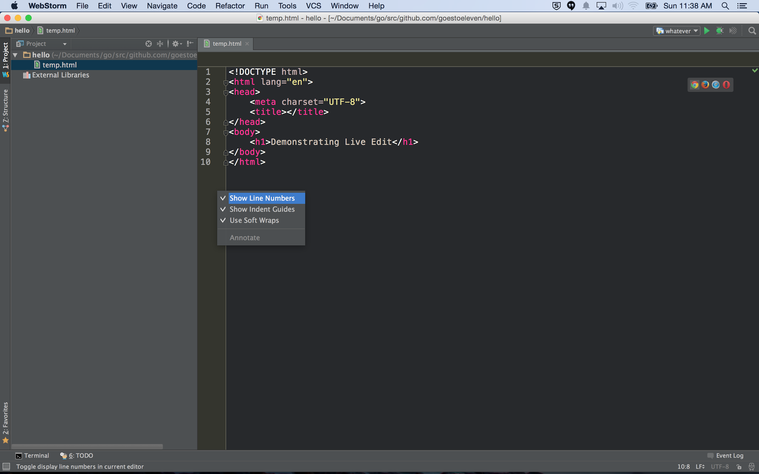

Slide 45
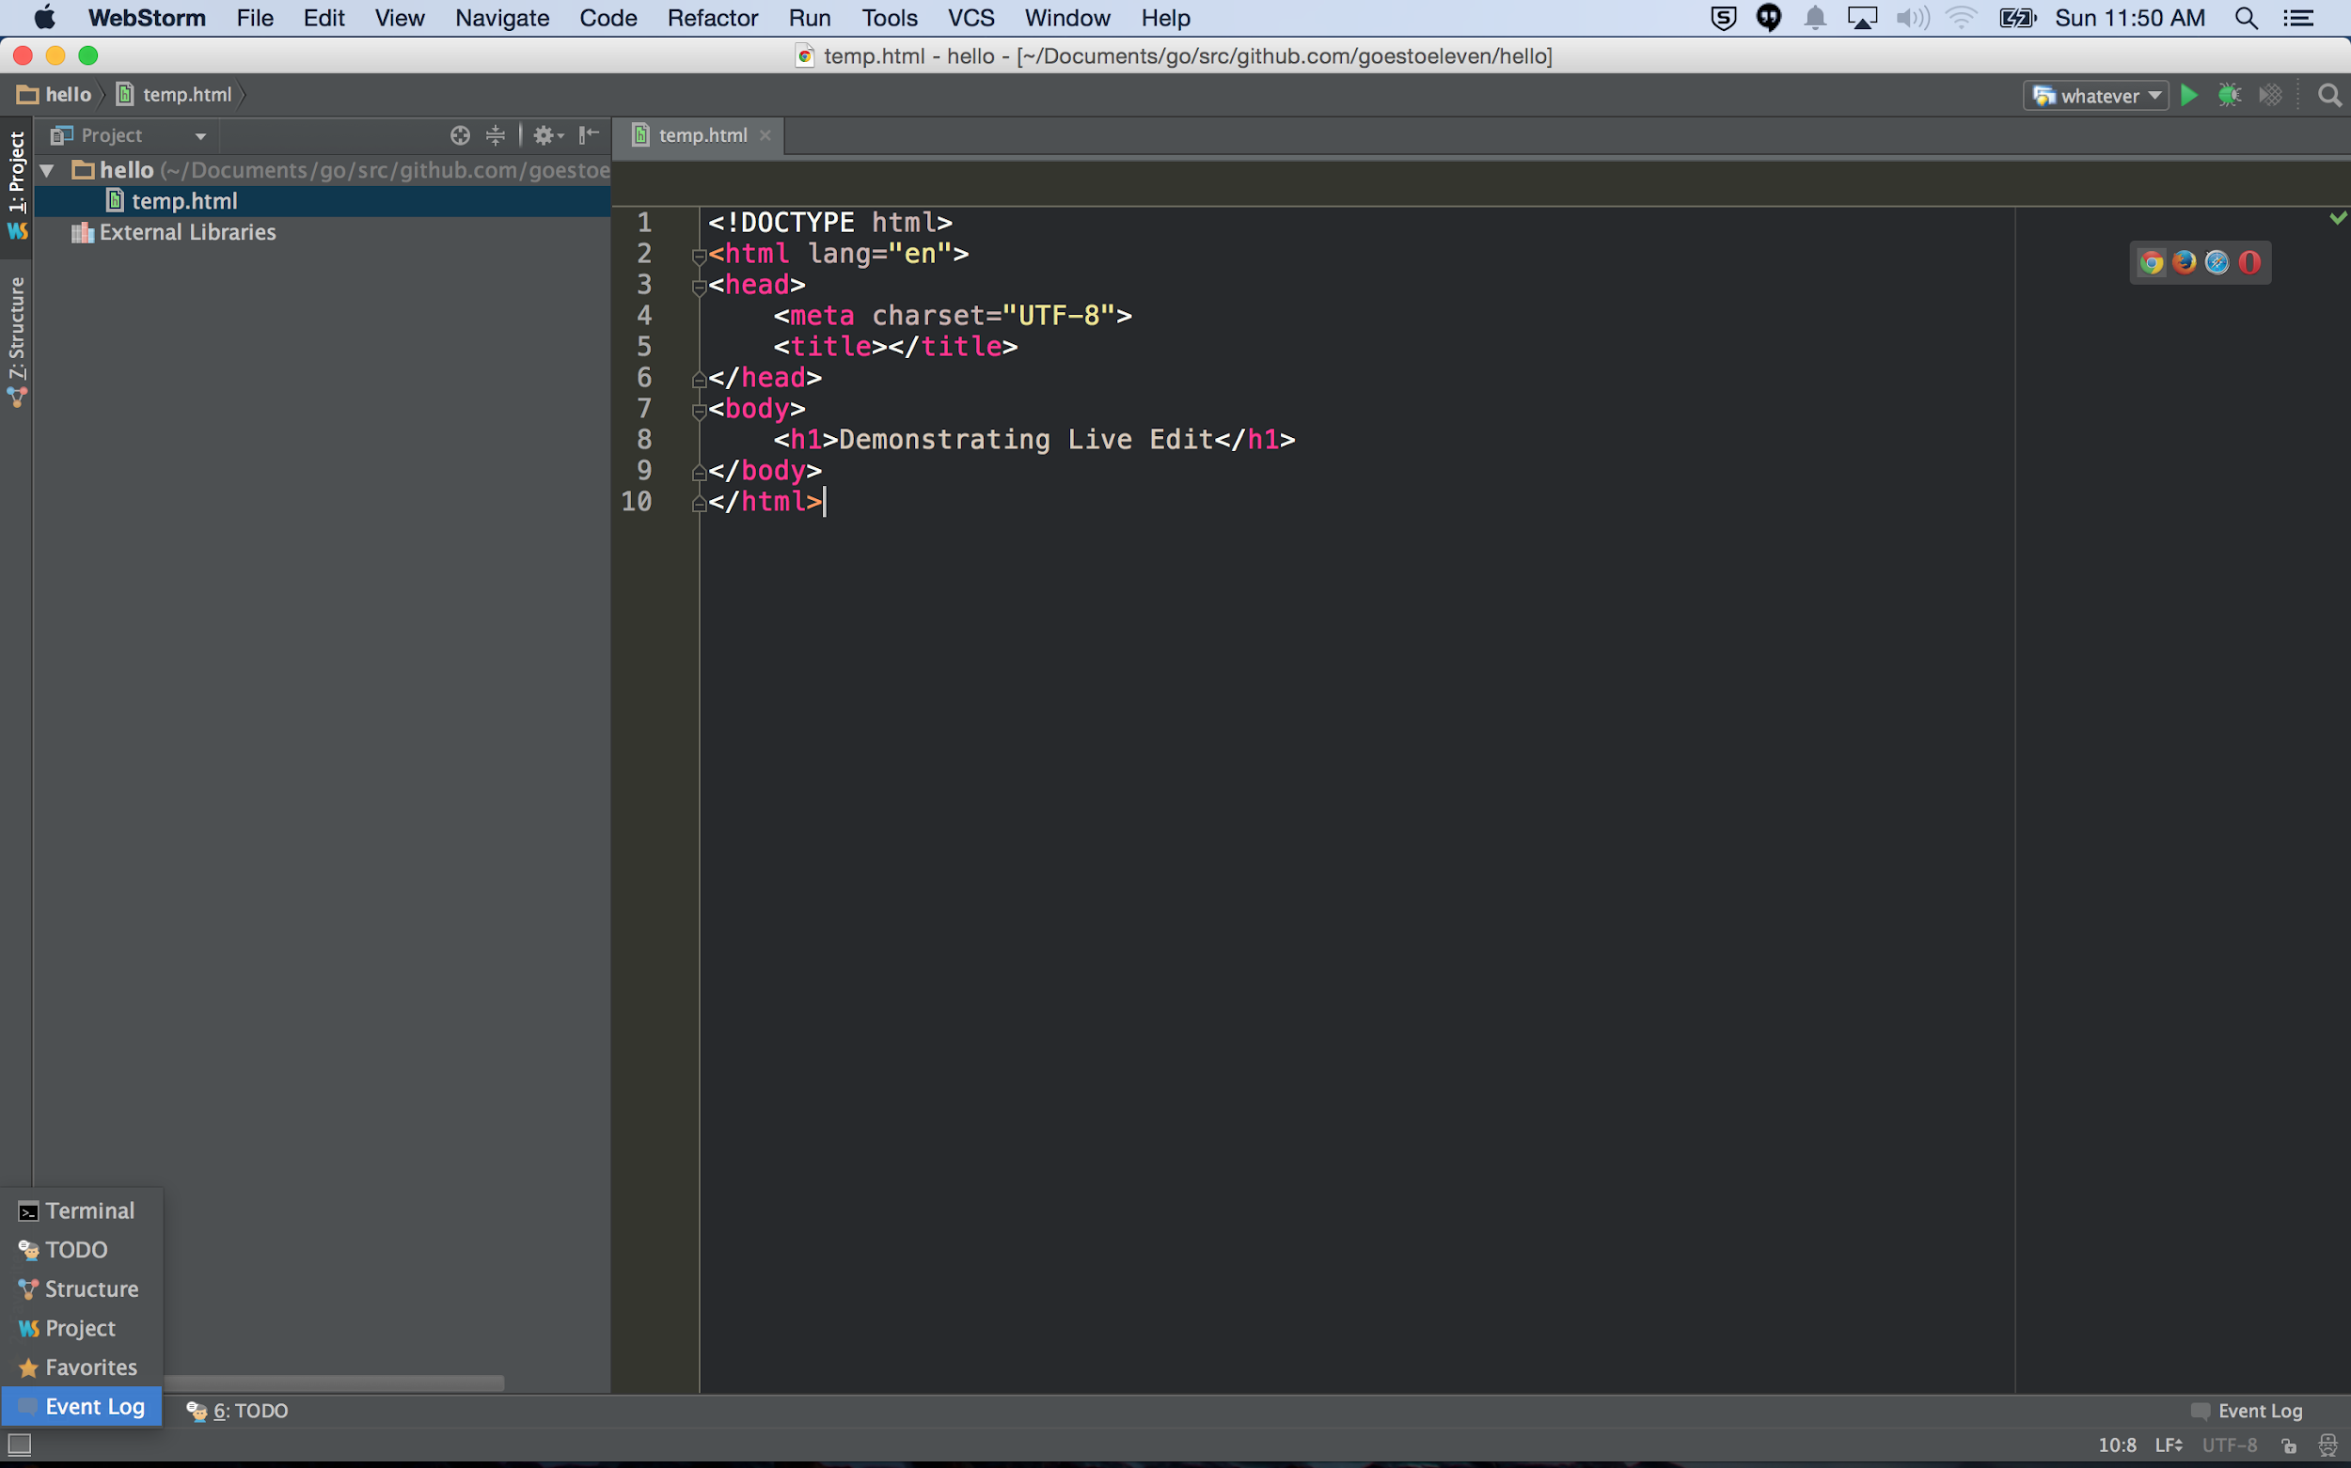

Slide 46
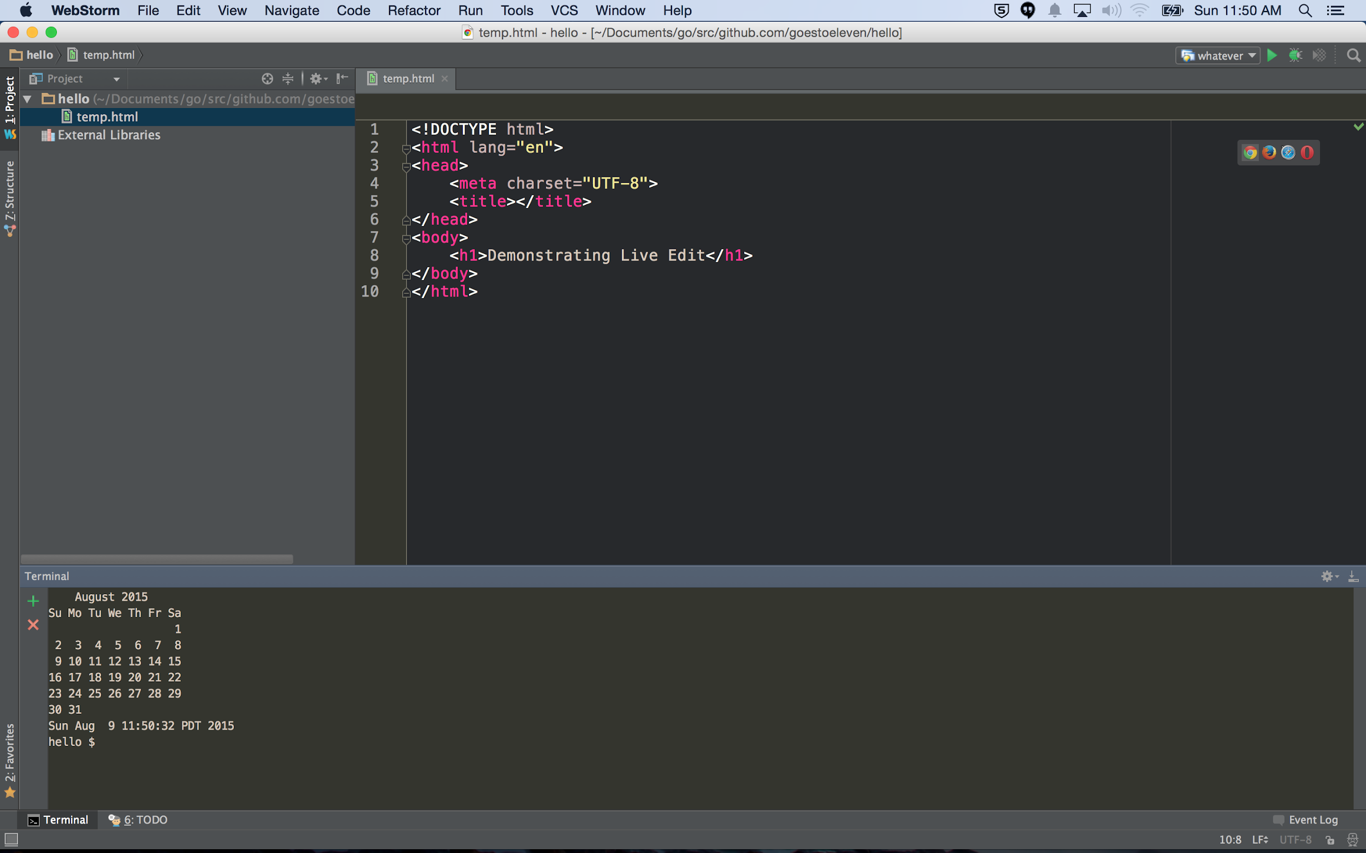

Slide 47
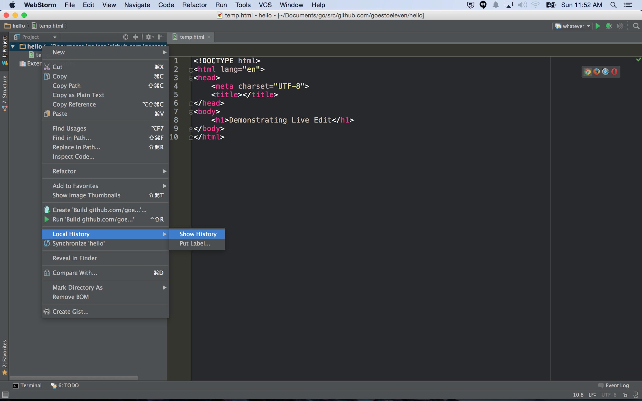

Slide 48
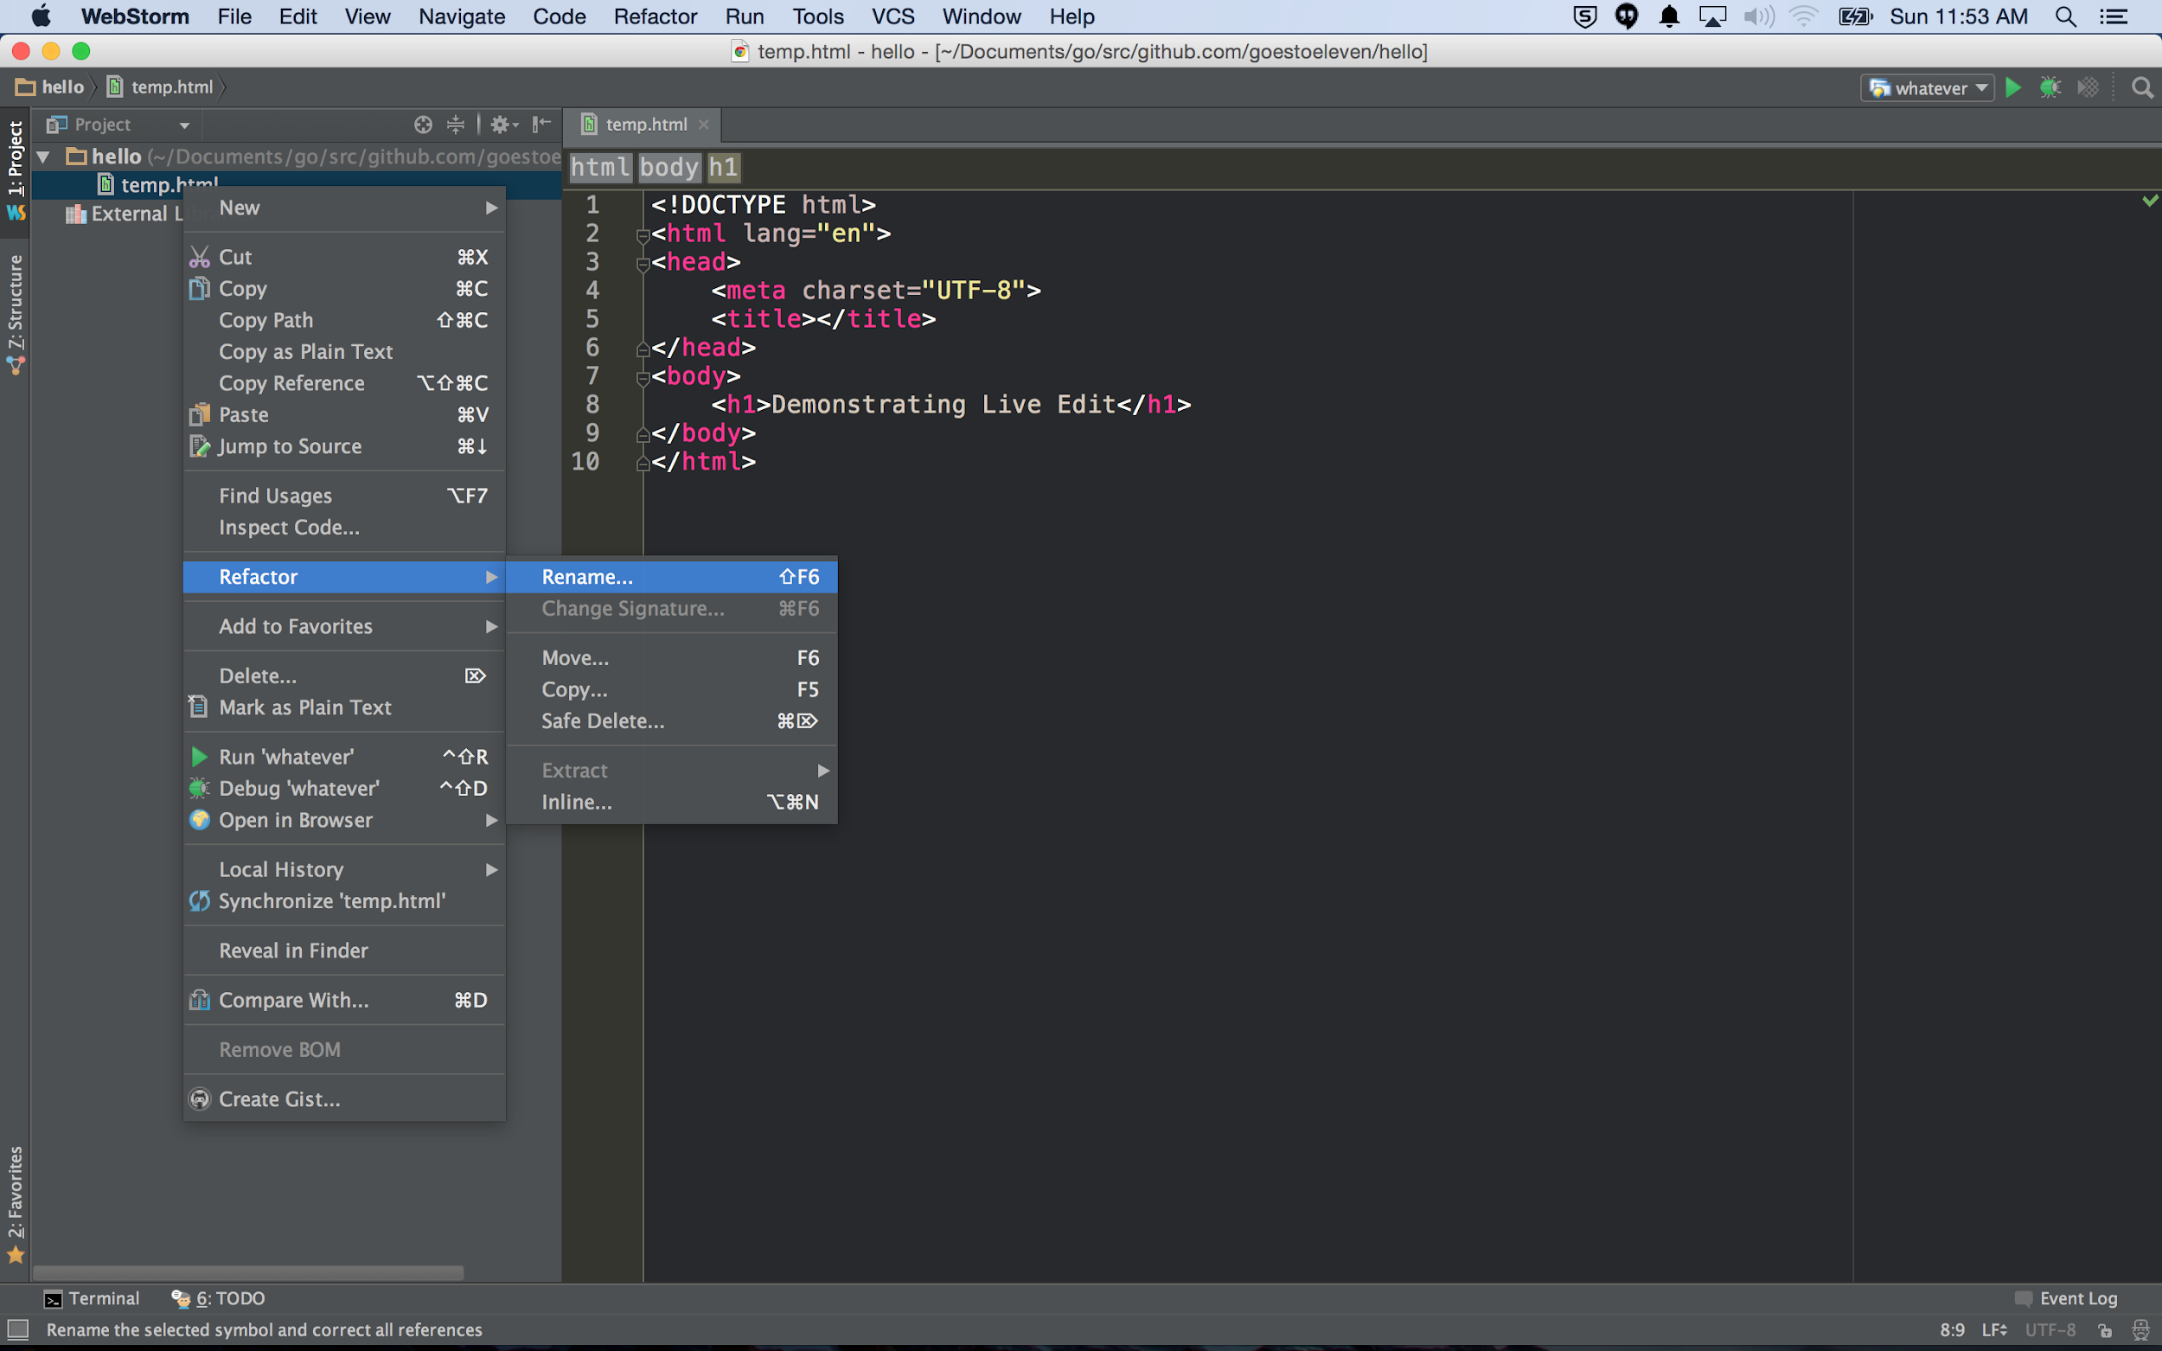

Slide 49
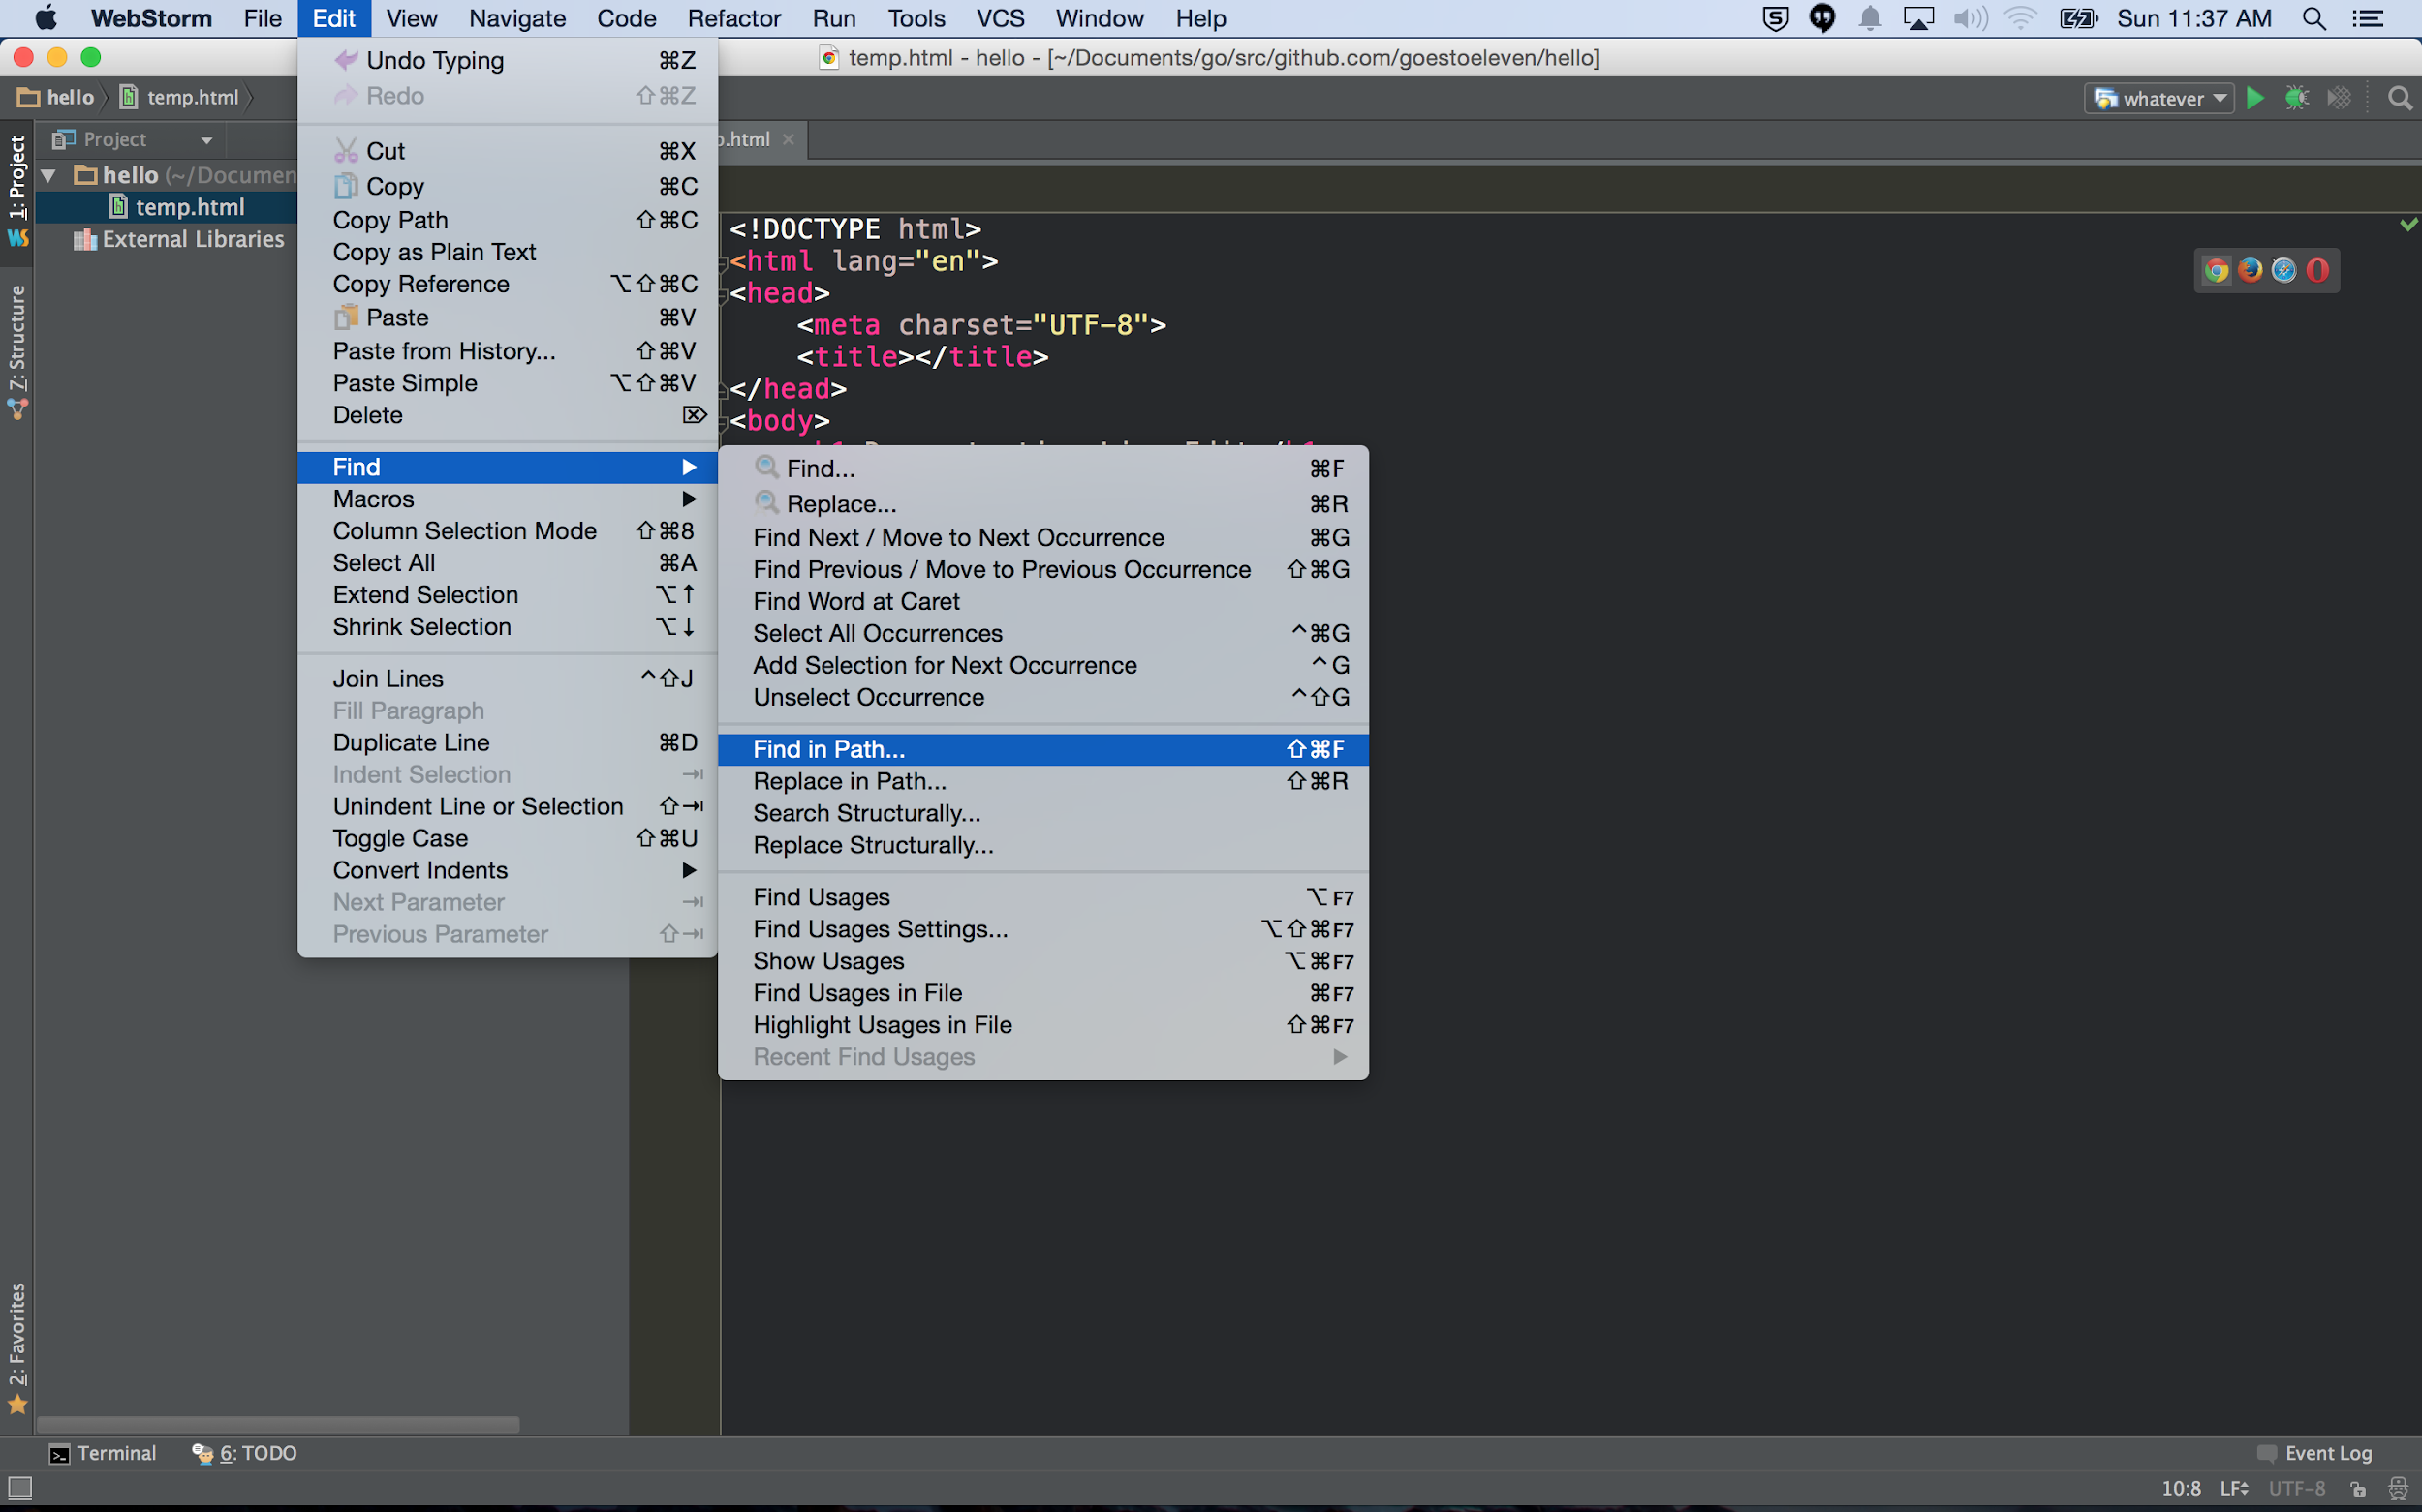

Slide 50
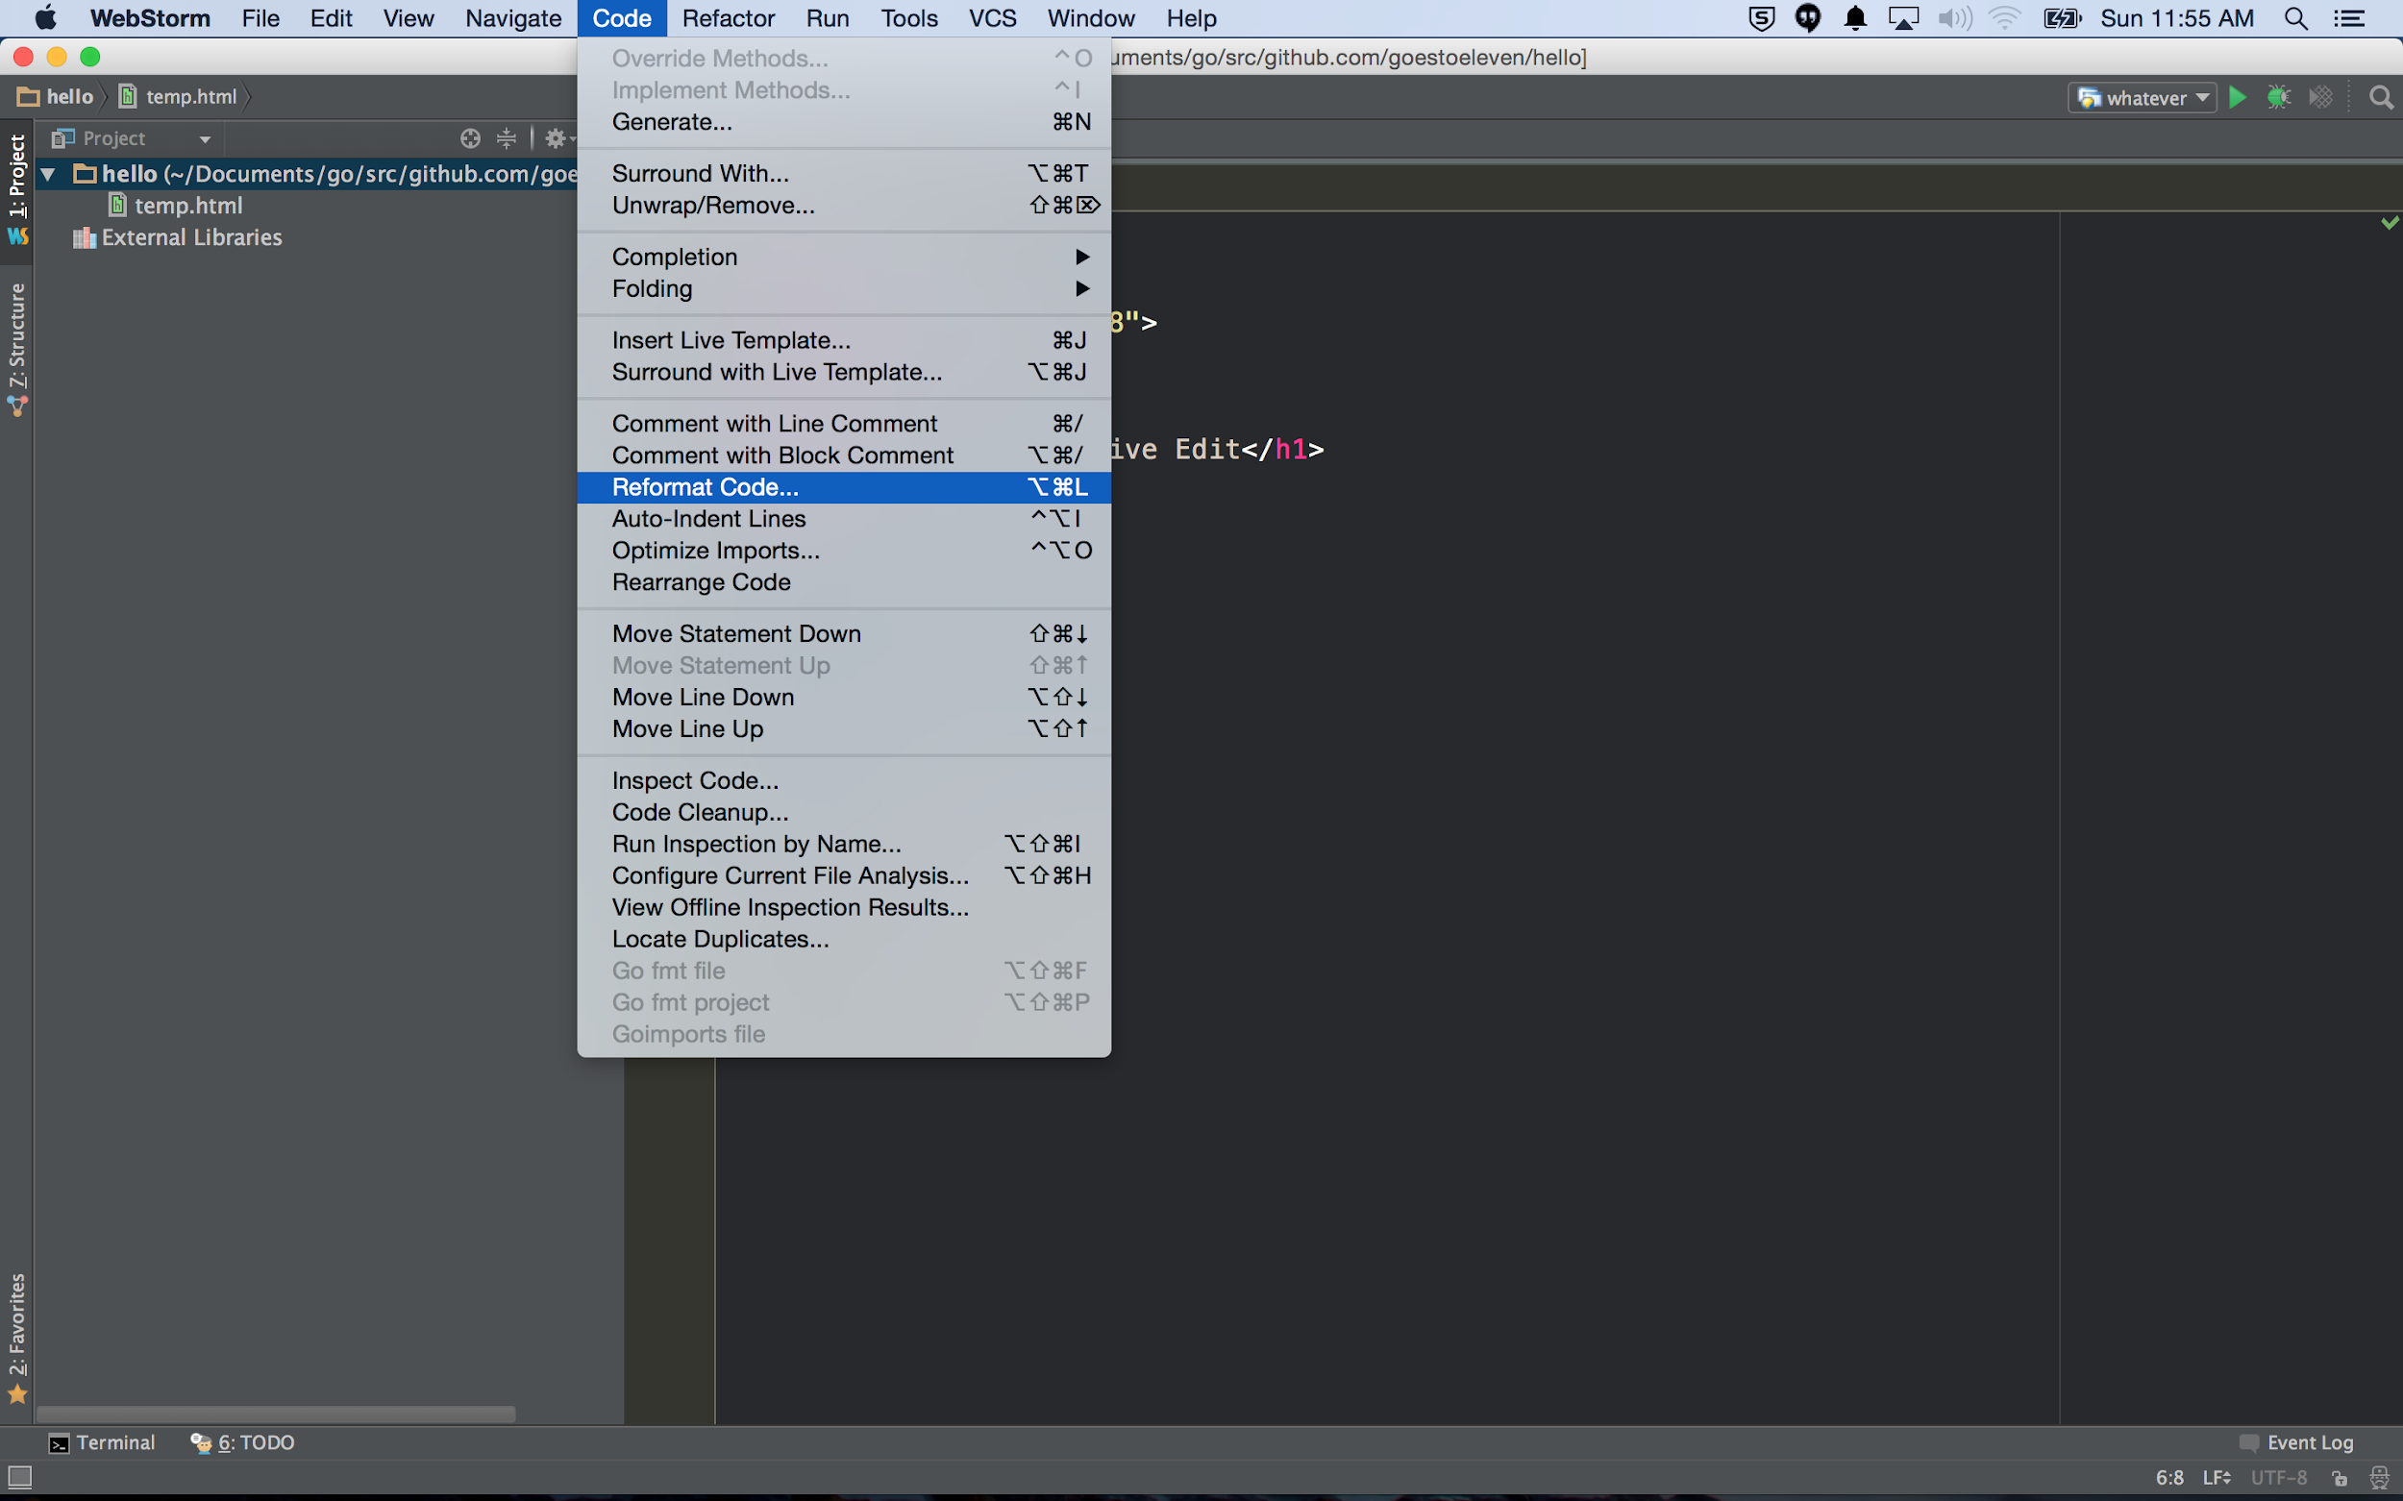

Slide 51
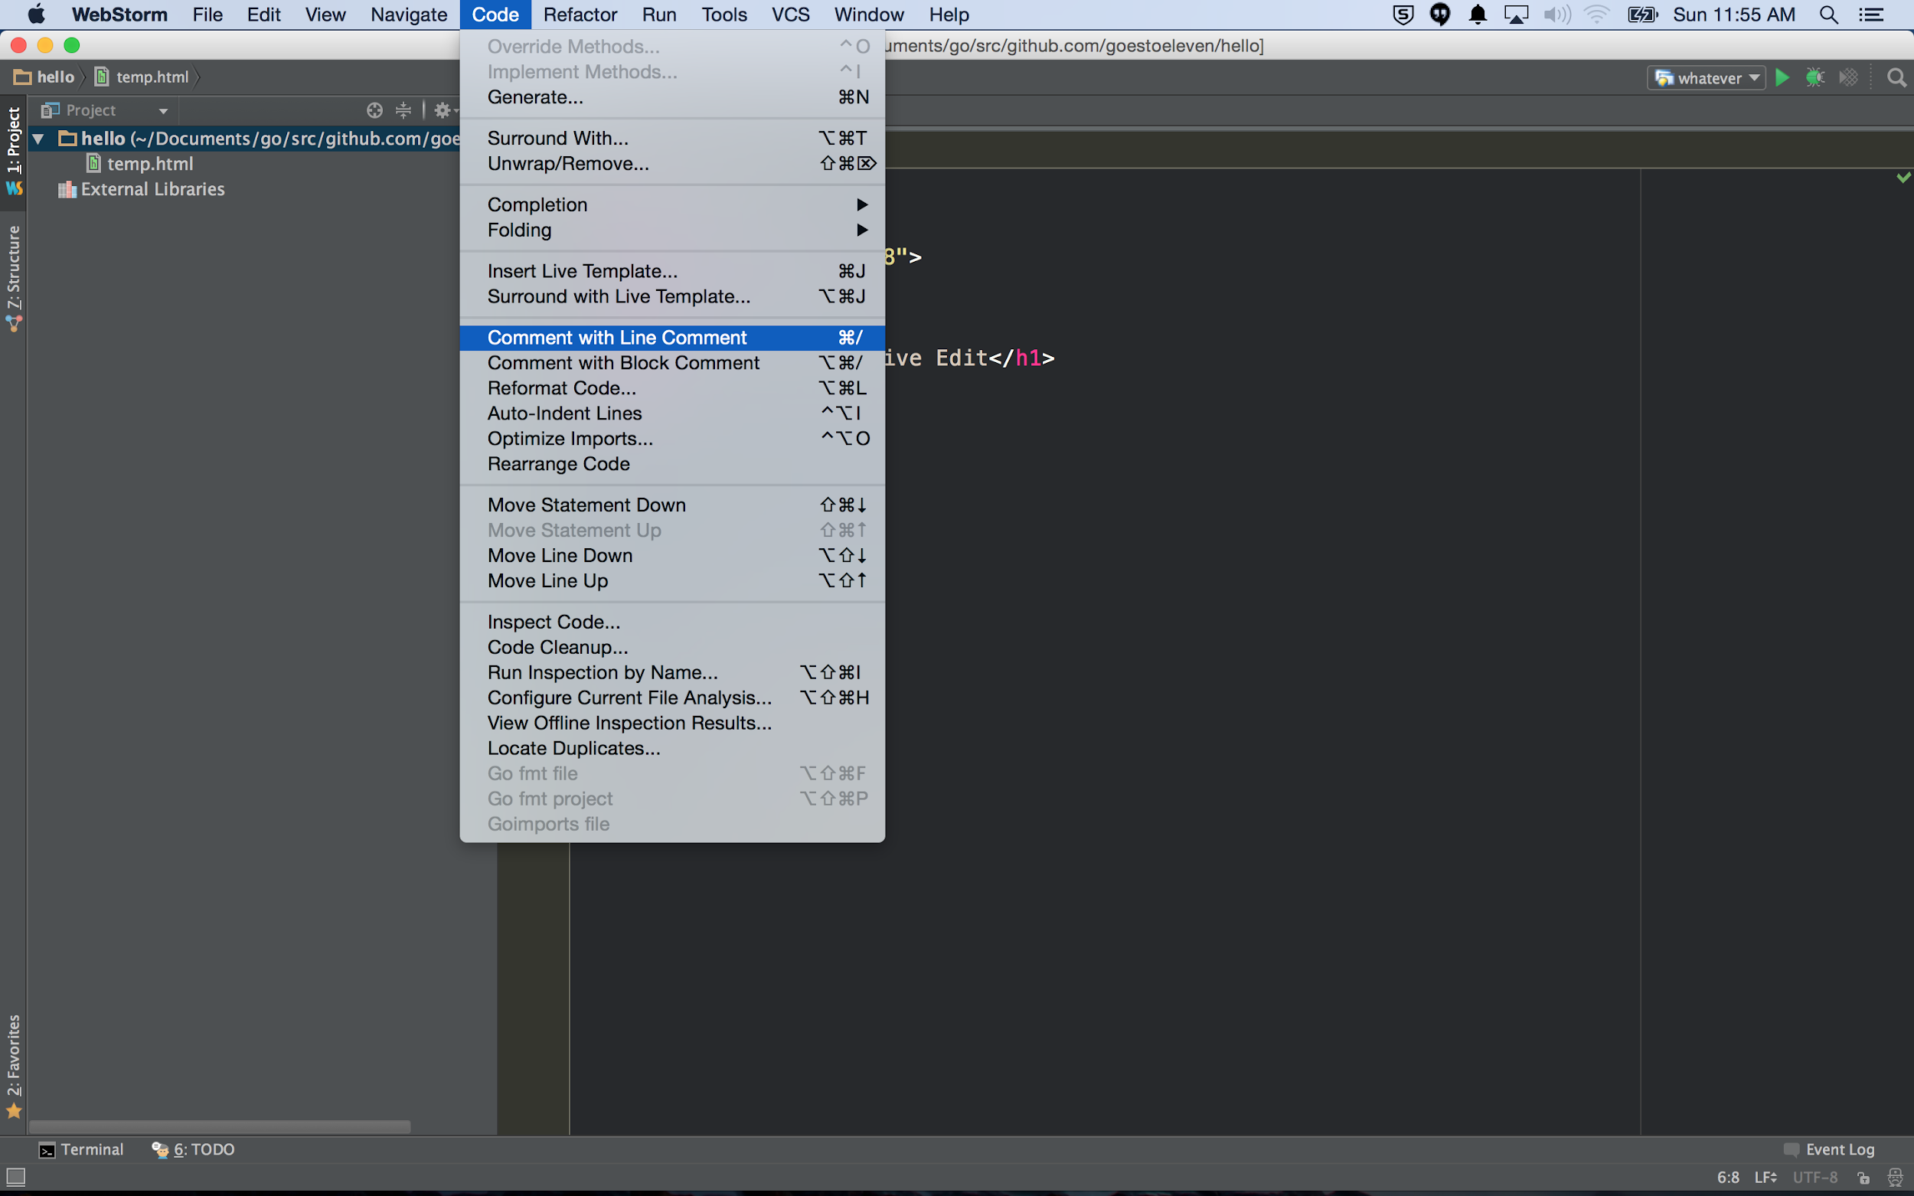

Slide 52
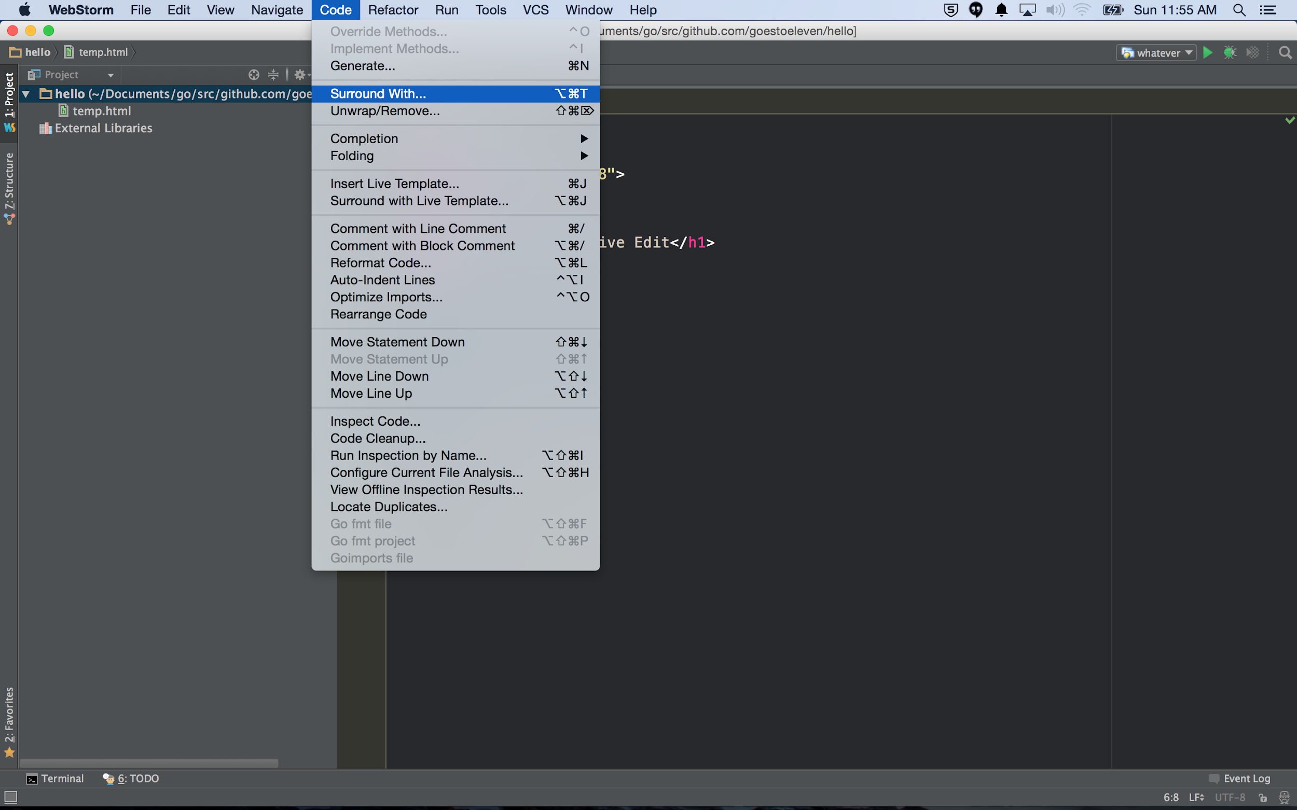

Slide 53
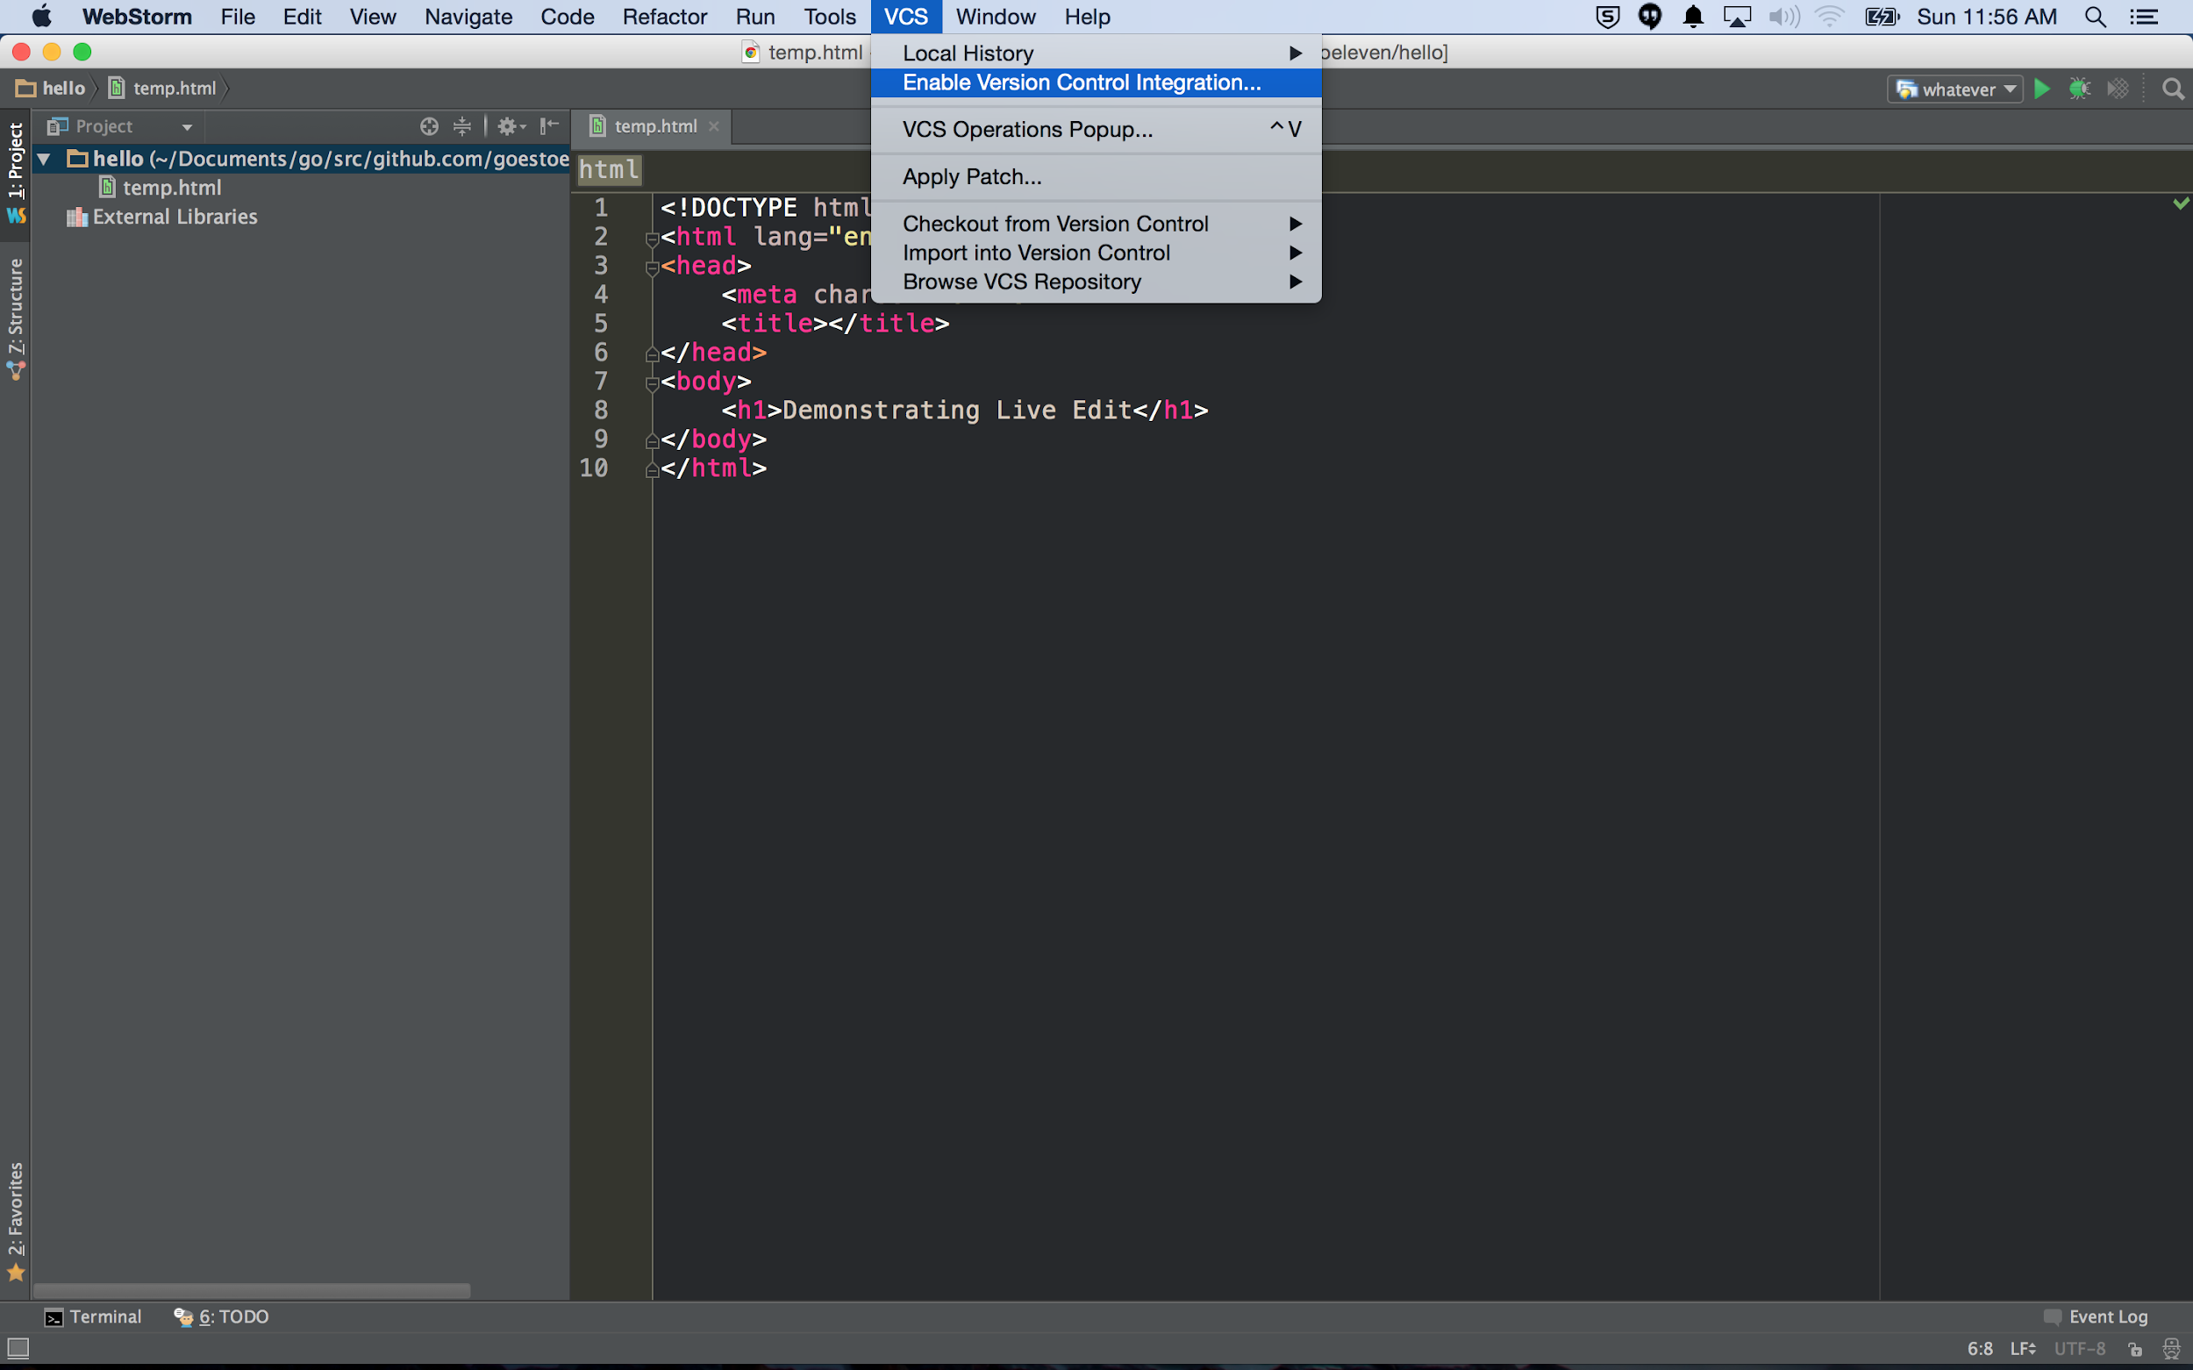

Slide 54
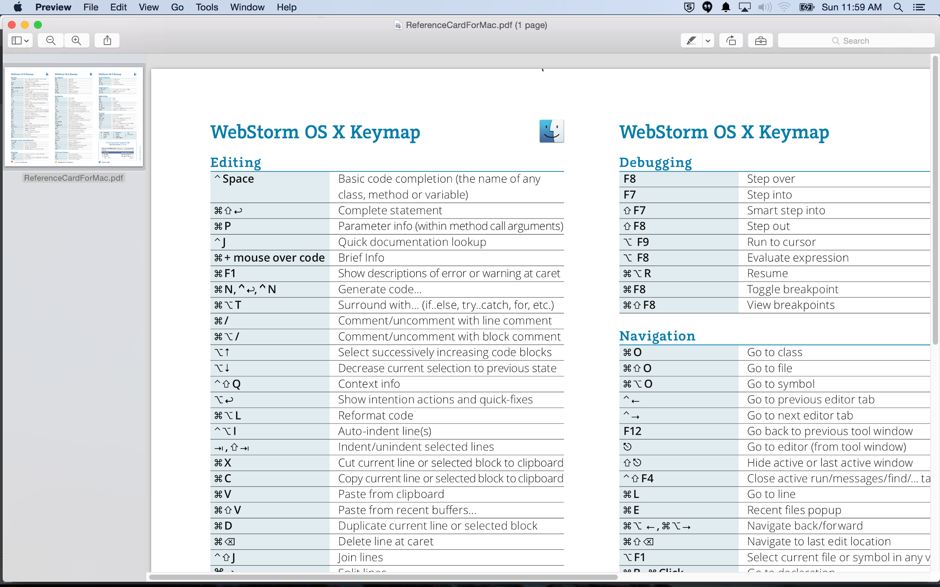

Slide 55
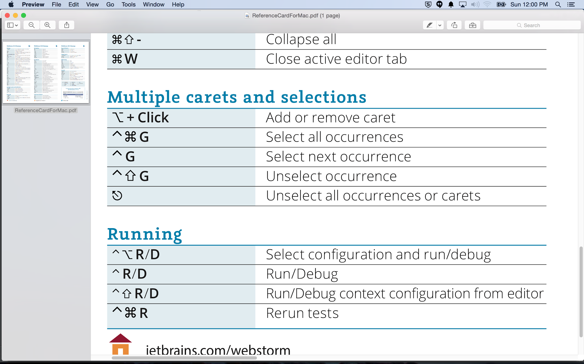

Slide 56
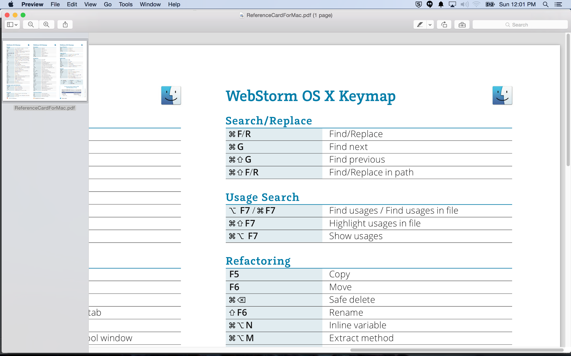

Slide 57
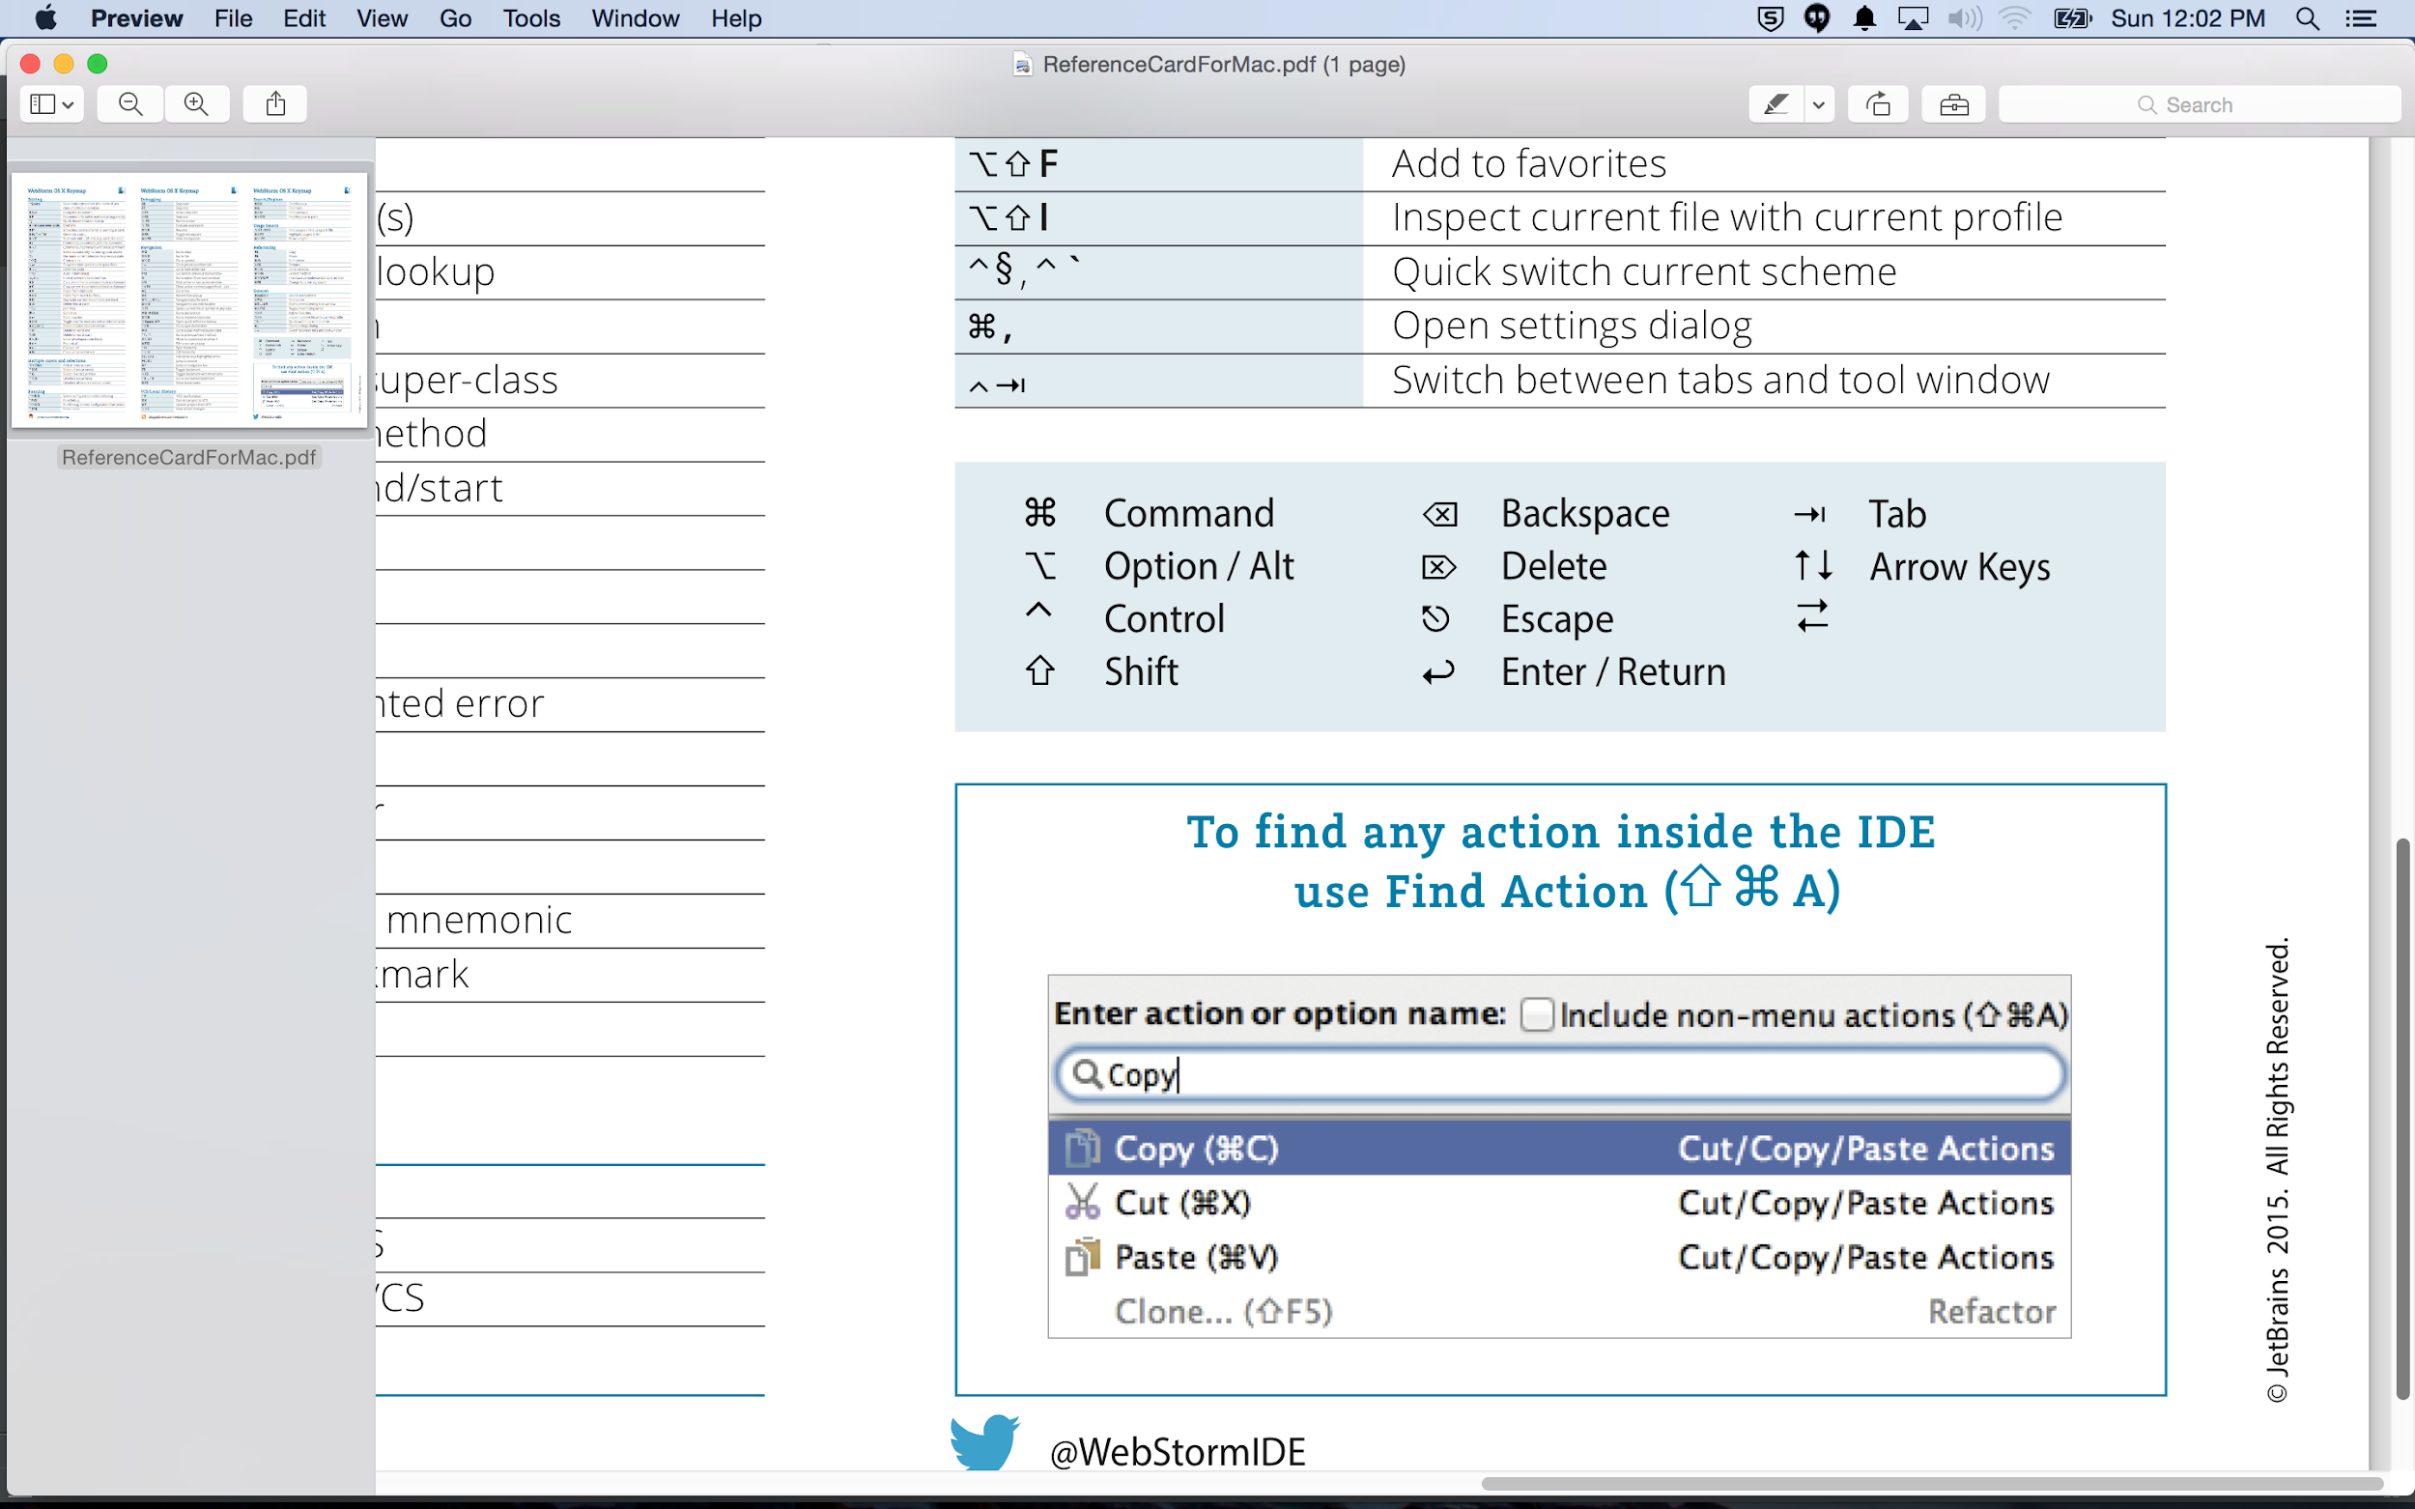

Slide 58


jump cursor to end/beginning of code

Slide 59
atom
https://atom.io/

Slide 60

atom
made by Github

Slide 61
go-plus
https://atom.io/packages/go-plus

Slide 62
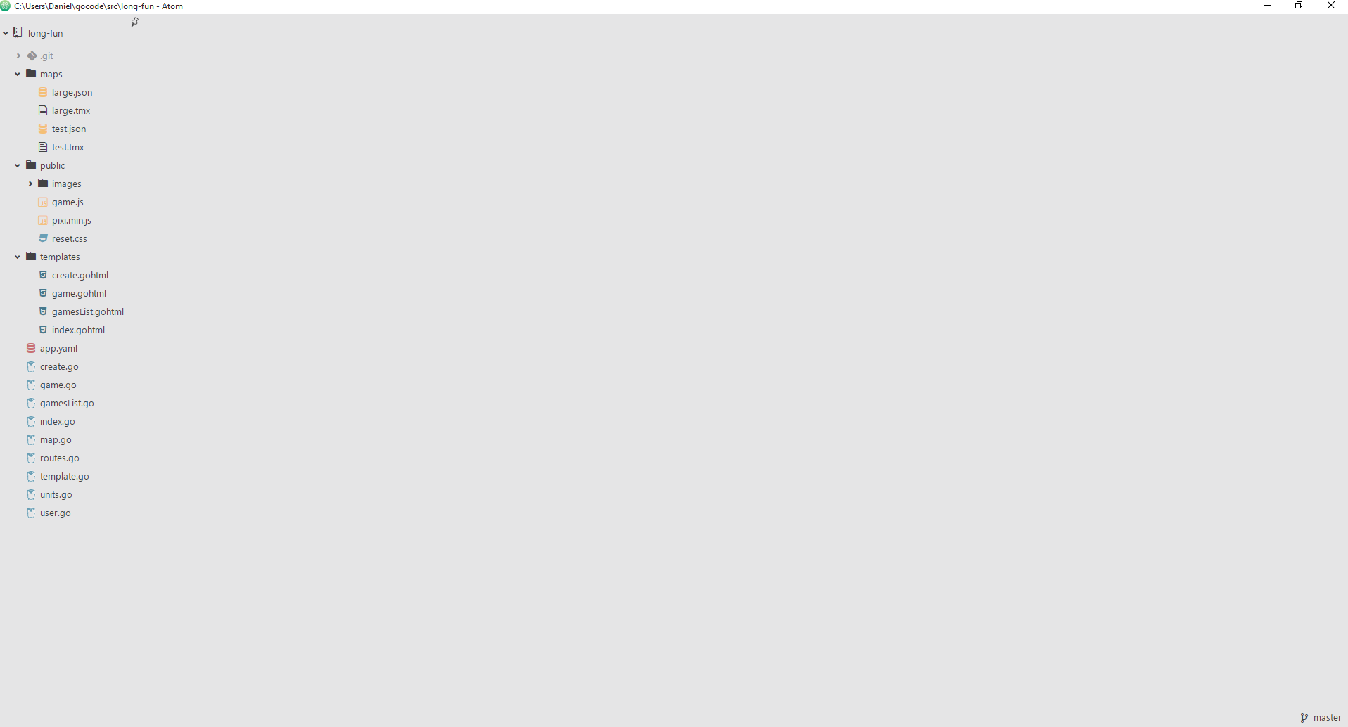

Slide 63
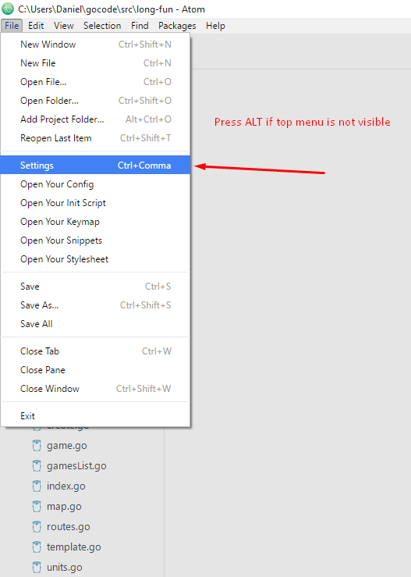

Slide 64


Slide 65


Slide 66


Slide 67
Review
IDE’s
Webstorm
plugins
golang plugin
creating a new project || package || library
GO SDK
themes
http://www.ideacolorthemes.org/home/
live edit
JETBrains IDE Support Chrome Plugin
keymap
I have found helpful
preferences
search (search box in preferences)
right margin
wrap, soft wraps, folding
emmet
show line numbers
Webstorm (continued …)
show line numbers
terminal
local history
refactor / rename
find in path
reformat code
comment
surround with
VCS
ATOM
made by github
go-plus plugin

